Slide 1

RUNGTA COLLEGE OF DENTAL SCIENCES AND RESEARCH
Dental Cast Surveyor and Surveying Procedure.Path of insertion and Removal
Part 2
Dept of Prosthodontics
3rd Year BDS
Presented By:
Dr.Shilpi Karpathak
Professor
Dept of Prosthodontics

Slide 2
Specific Learning Objective
Core areas | Domain | Category
Introduction Definitions Surveyor types , parts , uses | Cognitive | Must Know
Surveying the diagnostic cast Surveying the master cast Survey lines | Cognitive | Must Know
 | Psychomotor | Must Know
Summary | Affective | Must Know

Slide 3
contents
Introduction
Definitions
Surveyor types , parts , uses
Surveying the diagnostic cast
Surveying the master cast
Survey lines
Summary
references

Slide 4
Surveying diagnostic cast This is done before the treatment plan is formulated.
The main objective of surveying the diagnostic cast is to determine the most desirable path of placement (insertion) that will eliminate or minimize the interference to the placement and the removal of prosthesis.
This basically involves determining the most favourable tilt of the cast with respect to various factors involved in determining the path of placement.

Slide 5
Mounting of cast-The cast to be designed, whether maxillary or mandibular, is first attached to the cast holder such that occlusal plane is parallel to the base. the starting point for the surveying procedure
Tilting-Tilting changes the position of the cast, which in turn changes the long axis of each tooth on the cast relative to the horizontal plane.
Tilt is seen from the view of a person looking at the cast from the rear.
Thus, if anterior part of cast is lowered, it is called anterior tilt.
Similarly the cast can be tilted posterior, right, left or a combination of these
Tilting more than 10° from the horizontal should be avoided as the patient would be unable to open the mouth sufficiently to accommodate this exaggerated tilt. The final tilt determined after considering the factors affecting the same will give the final path of placement of the prosthesis.

Slide 6
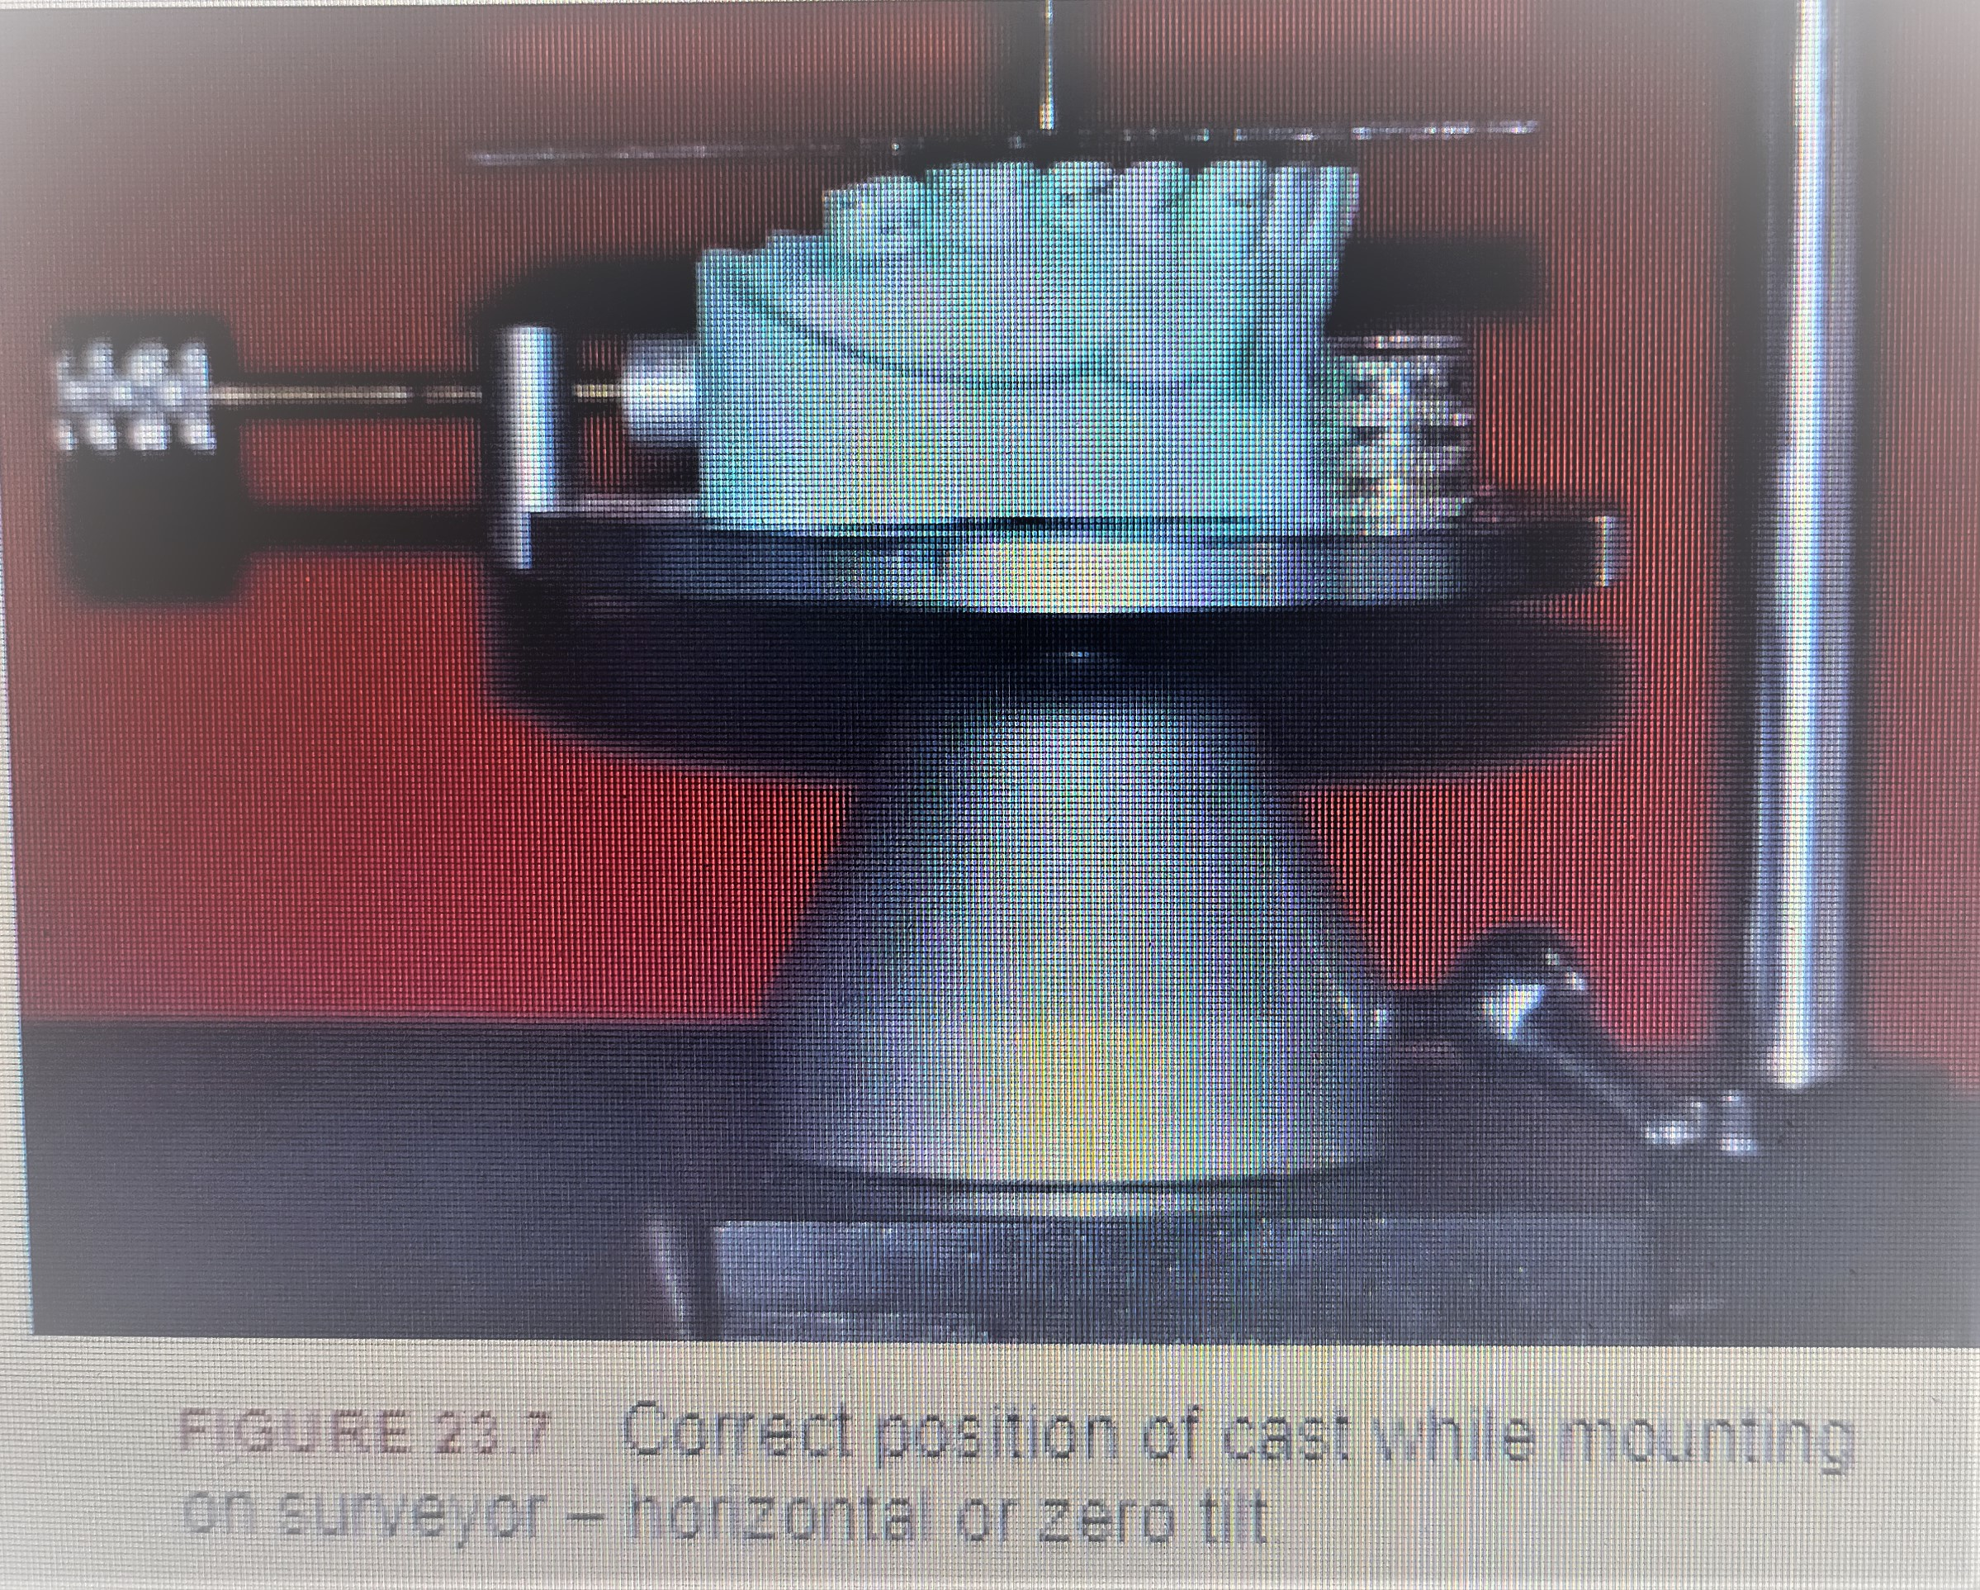

Slide 7
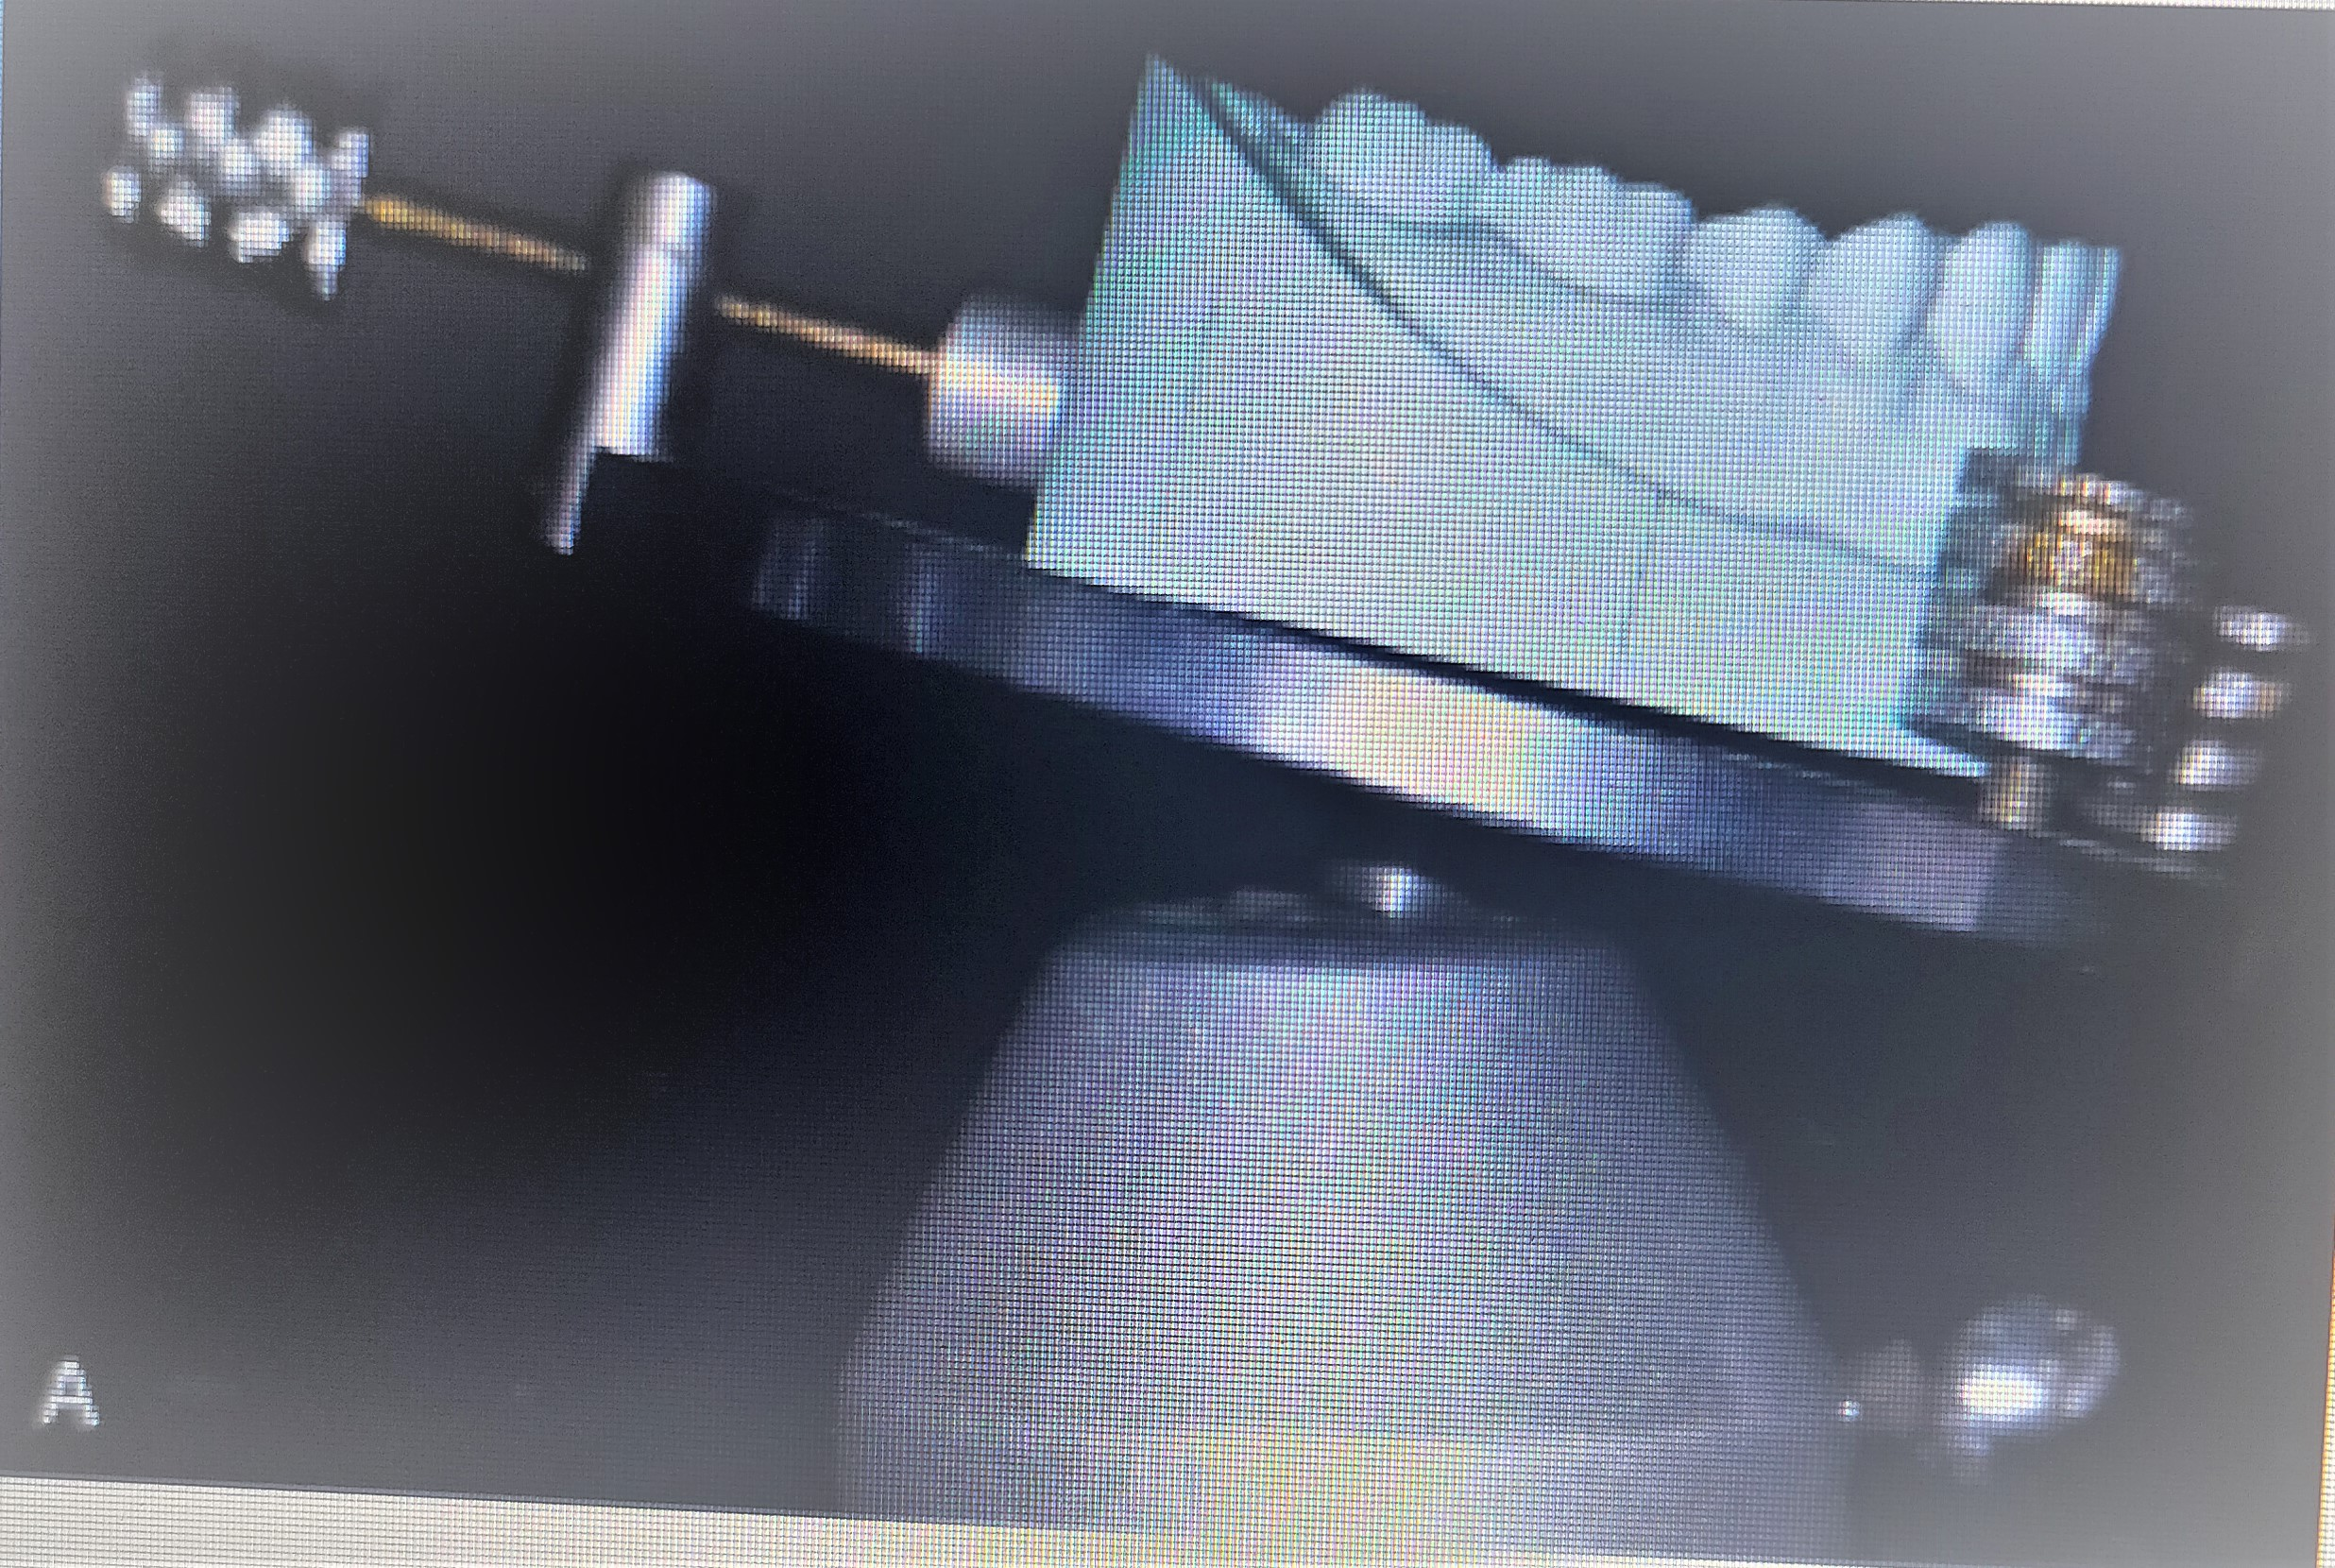

Slide 8
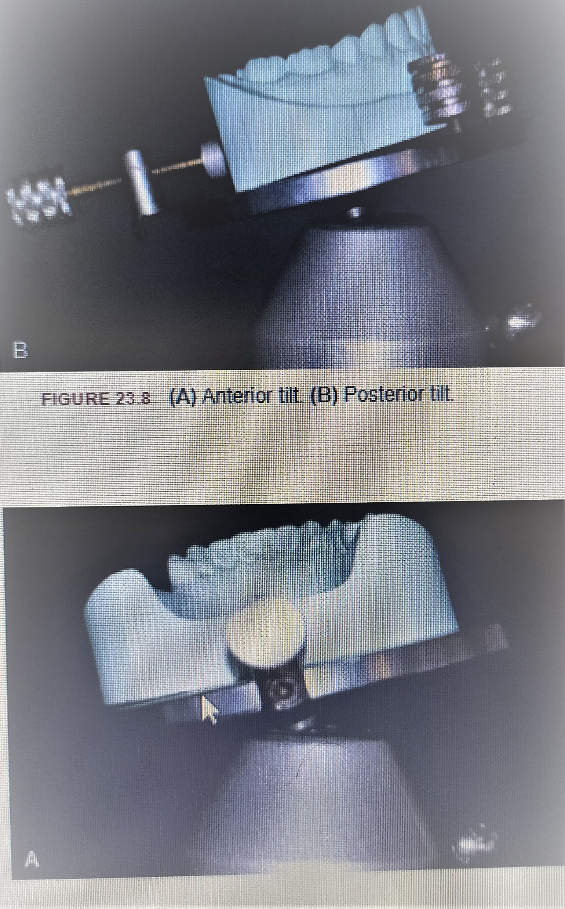

Slide 9
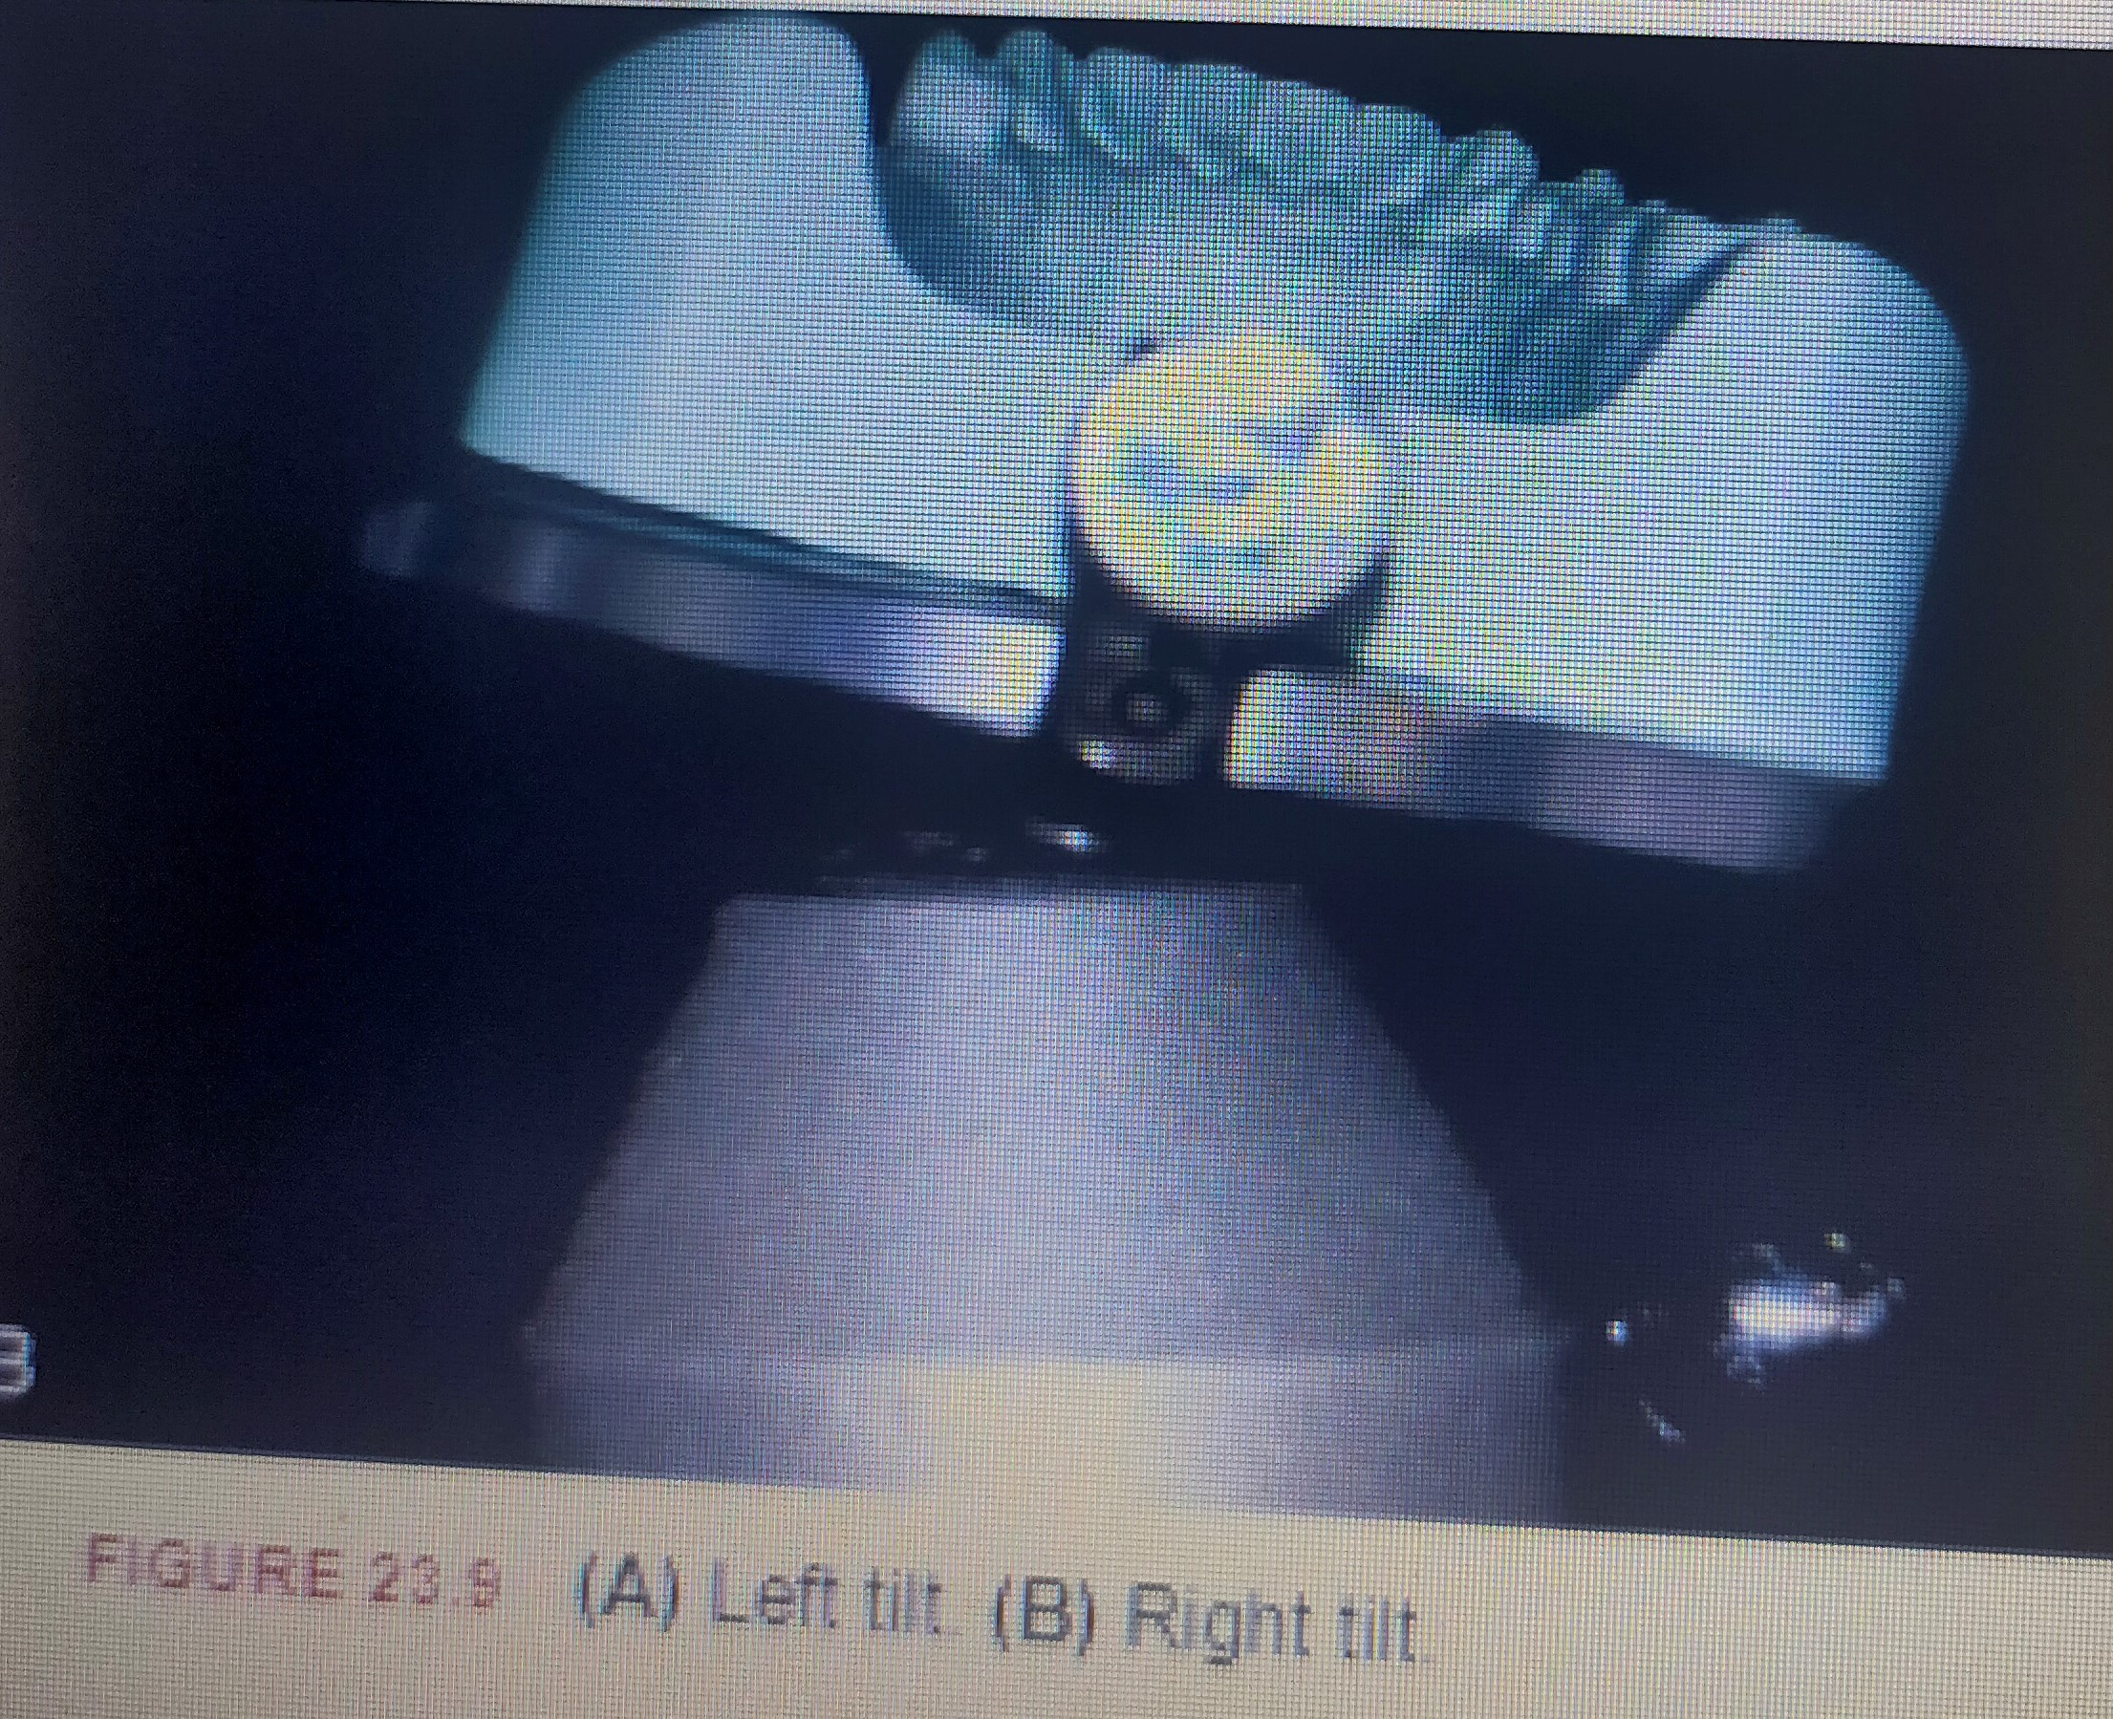

Slide 10
In general, anteroposterior tilts will influence the guiding planes, while the right and left lateral tilts will change amount of the retentive undercuts, which in turn will affect placement of retentive and reciprocal arms.

Slide 11
Path of placement or insertion-As previously noted, the tilt of the cast determines at what angle the partial denture will seat over the remaining teeth. This angle is referred to as the path of placement. All the various factors that influence this seating of the restoration should be considered to determine the final path. It will always be parallel to the vertical arm of surveyor
The number of paths of placement may be single or multiple depending on whether the edentulous space is tooth borne or distal extensions. If it is completely tooth borne like a class III situation, then the prosthesis will have a single path of placement. In case of Kennedy’s class II with a modification on the opposite side, again there will be a single path as the same is controlled by the guide planes on the tooth bound side

Slide 12
In a class I situation, there will be multiple paths of entry and exit of prosthesis on the abutments and additional guide planes on lingual surfaces of other teeth may be needed to restrict the number of paths . The class IV situation will usually have a single path parallel to the proximal surface of abutment teeth

Slide 13
Factors affecting the path of insertion:
It may be impossible to achieve the optimum among all factors which affect the path of insertion as one or other may need to be compromised. It is only clinical judgment which finally dictates and may be compromised without sacrificing the quality of service.

Slide 14
The following four factors should be considered before final path of placement is selected.
1. Retentive undercuts
2. Interferences
3. Aesthetics
4. Guiding planes

Slide 15
1. Retentive undercuts
The most important rule to consider is that retentive undercuts must be present on the abutment teeth at the horizontal or 0° tilt. As dislodging forces are always perpendicular to the horizontal plane, even if cast is tilted to create undercuts on the abutments , there will still be no resistance to forces in this direction. This is first checked using the analysing rod attached to the vertical arm and examining the buccal surface of the abutments

Slide 16
If undercuts are not present, they must be created. This can be done by recontouring the buccal surface if only slight modification is needed. Otherwise a crown is made on the abutment with the desired undercut.
• When retentive undercuts are found at horizontal tilt, it may be changed to alter the amount of undercut on abutments . Tilting is also used to increase the desirable undercuts and to decrease undesirable undercuts on abutments. The available undercuts could be distributed to obtain uniform retention. The right lateral tilt increases undercuts on buccal surfaces of teeth on right side and vice versa

Slide 17
Tilting can also lower the height of contour such that the retentive arm is placed at the gingival thirds of the abutment and not further occlusally. As already seen, this position of retentive arm enhances aesthetics and reduces the rotational forces transmitted by clasp on the abutments.
The undercut gauge is then used to get the desired amount of undercut after the survey line is scribed on the abutment . A 0.010 inch undercut is ideal for chrome alloys. For gold alloys and wrought alloys, more undercut can be utilized. The retentive terminal should be placed either at the distobuccal or mesiobuccal line angle in the gingival third of the clinical crown of abutment.

Slide 18
2. Interferences
Interferences to insertion of partial denture are mainly caused by:
Teeth
ii. Soft tissue undercuts
iii. Bony prominences or exostoses
They have to be eliminated either by tilting the cast or rarely by surgery.

Slide 19
Interferences in mandible
1. Lingual tori: If possible, relief can be provided under the major connector to minimize pressure on tori, but this can lead to compromise in thickness of major connector and tongue interference. The only other practical option is surgery to remove tori
2. Lingual tilt of posterior teeth: Remaining teeth in the mandible are frequently lingually inclined and tend to drift mesiolingually. If unilateral, cast may be tilted to get better path of insertion and undercut usage. If bilateral, major connector would have to be placed away from the lingual mucosa to be able to insert the prosthesis. This results in undesirable tongue interference and food entrapment. Solutions may be use of labial bar, lingual retention, recontouring, crowning and orthodontic uprighting of abutment teeth depending on severity of problem and patient compliance.

Slide 20
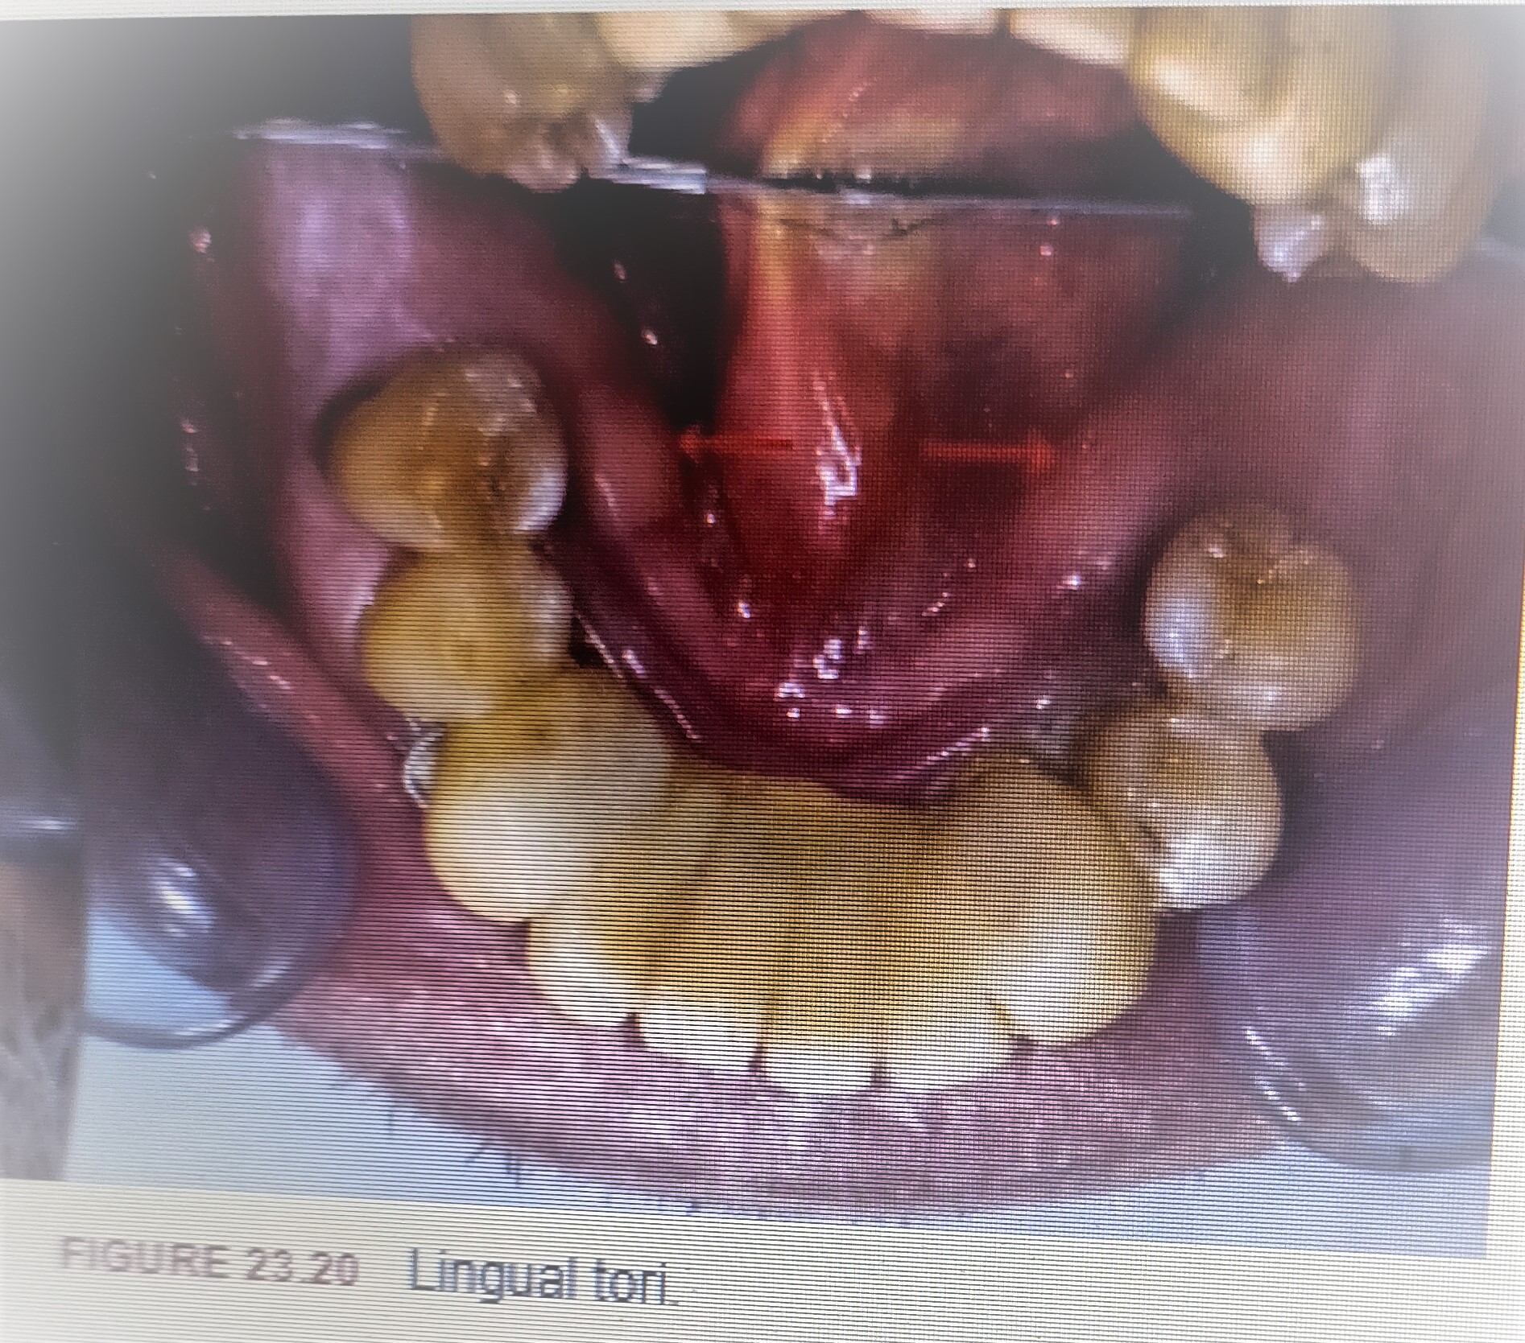

Slide 21
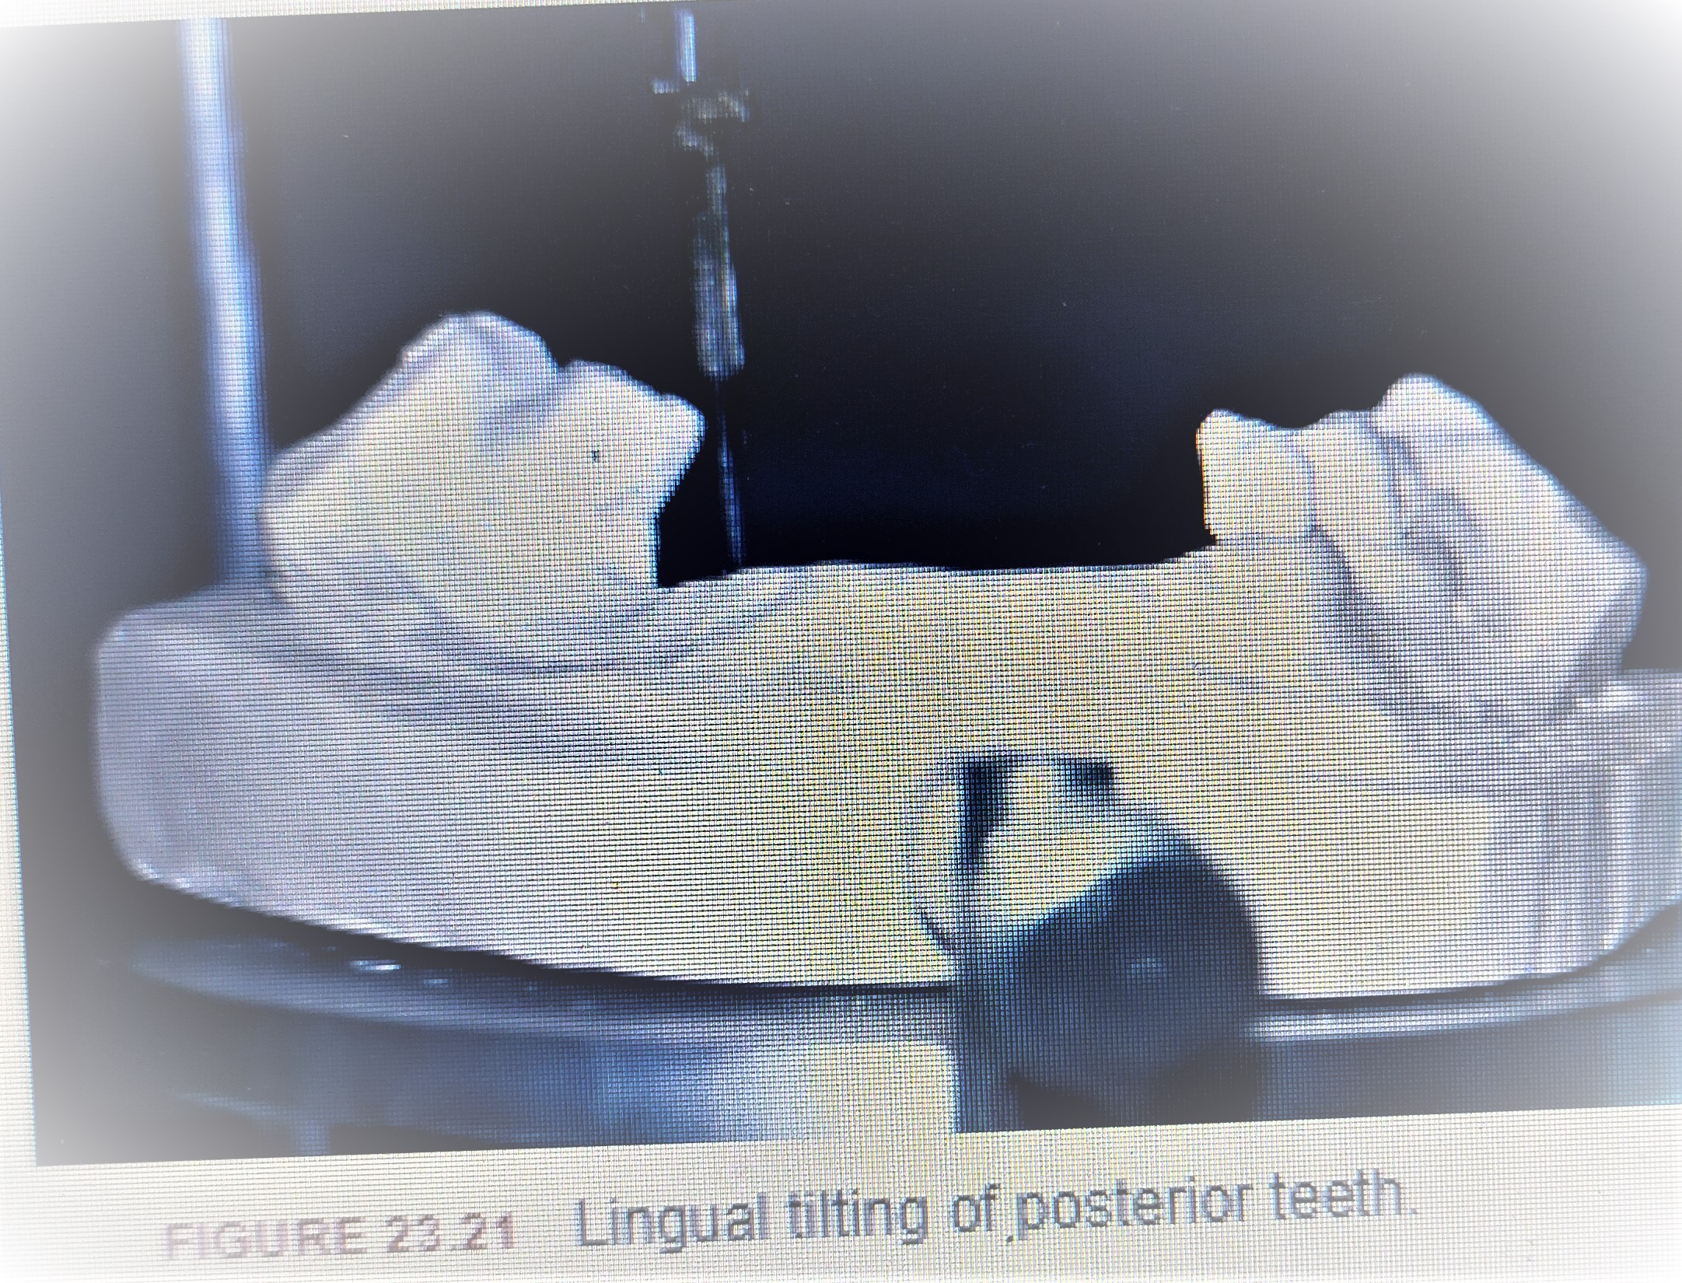

Slide 22
3. Area lingual to retromolar pad: If unilateral, lateral tilting of cast will solve problem . If bilateral, acrylic denture base can be trimmed to insert the denture or rarely surgery is indicated.
4. Bony prominence or undercuts: Undercuts buccal to premolars and canine are not uncommon. These interfere with denture base and placement of bar clasp. If mild – tilting, if severe – surgery.

Slide 23
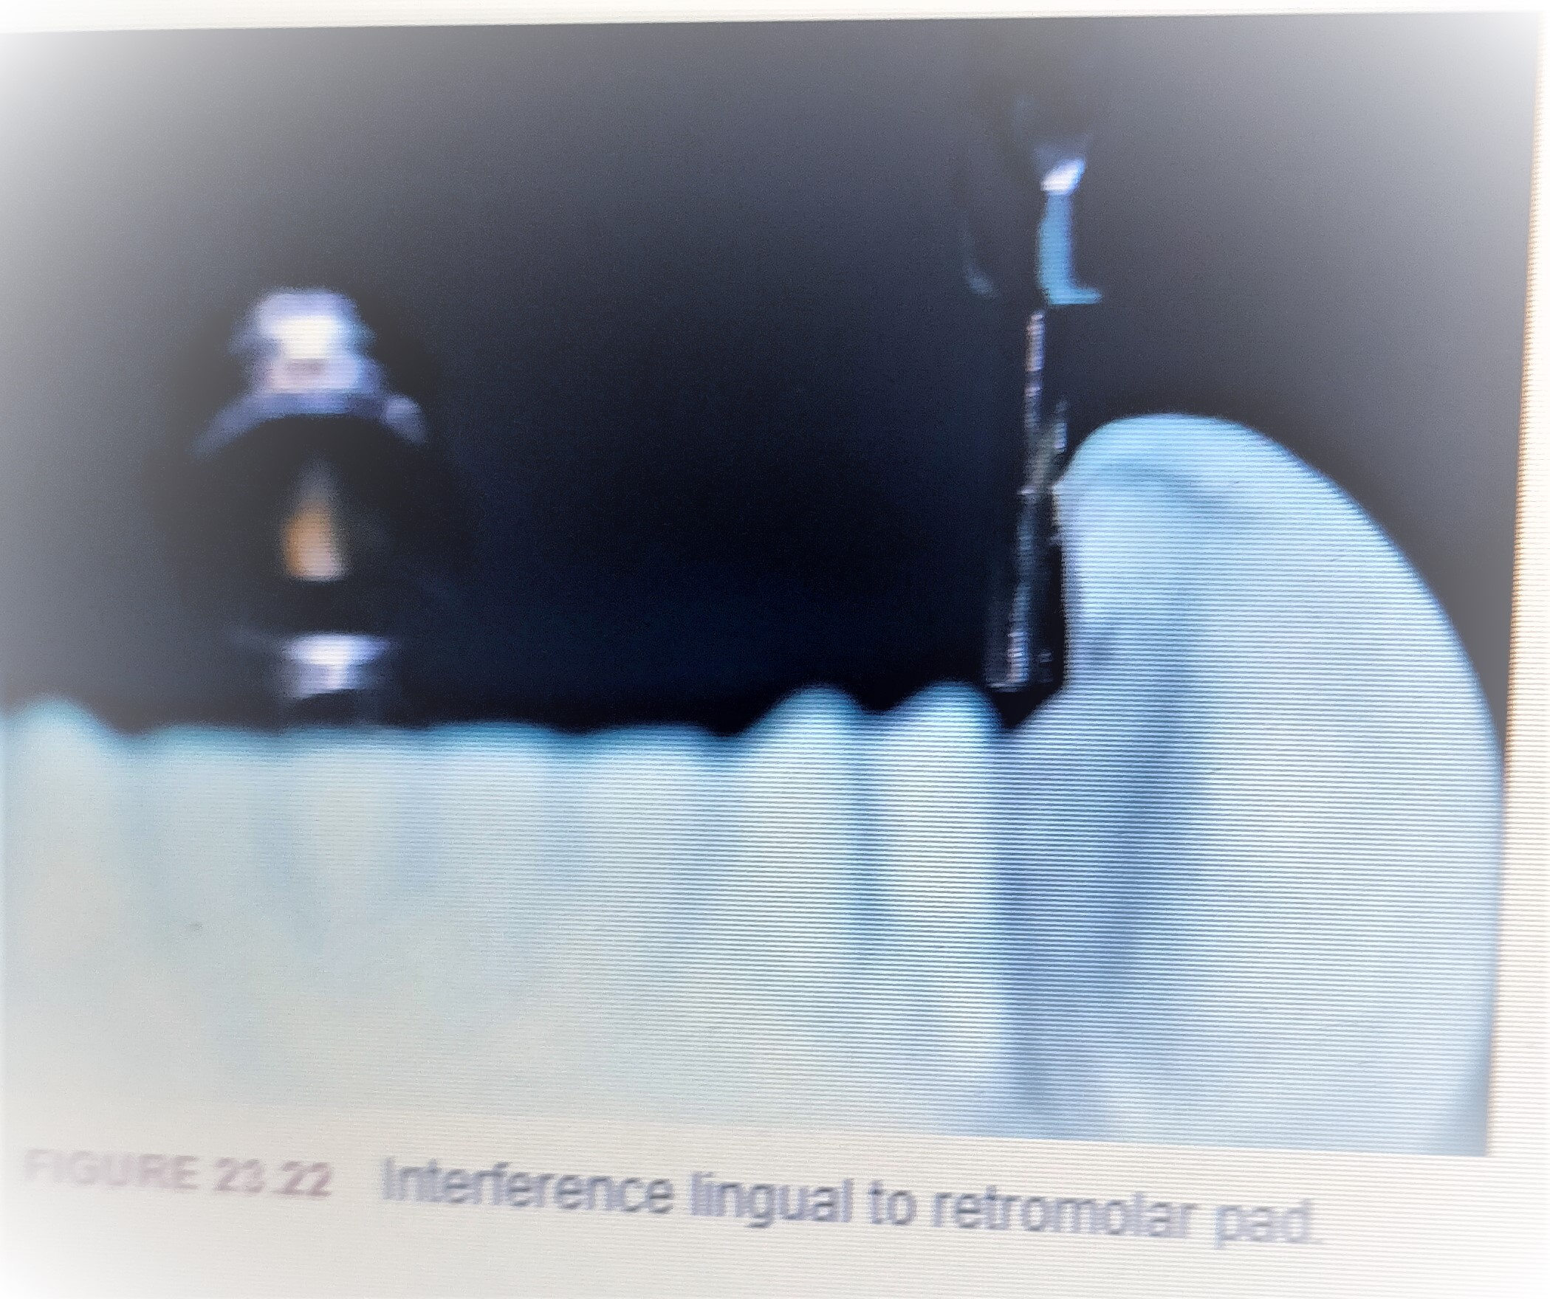

Slide 24
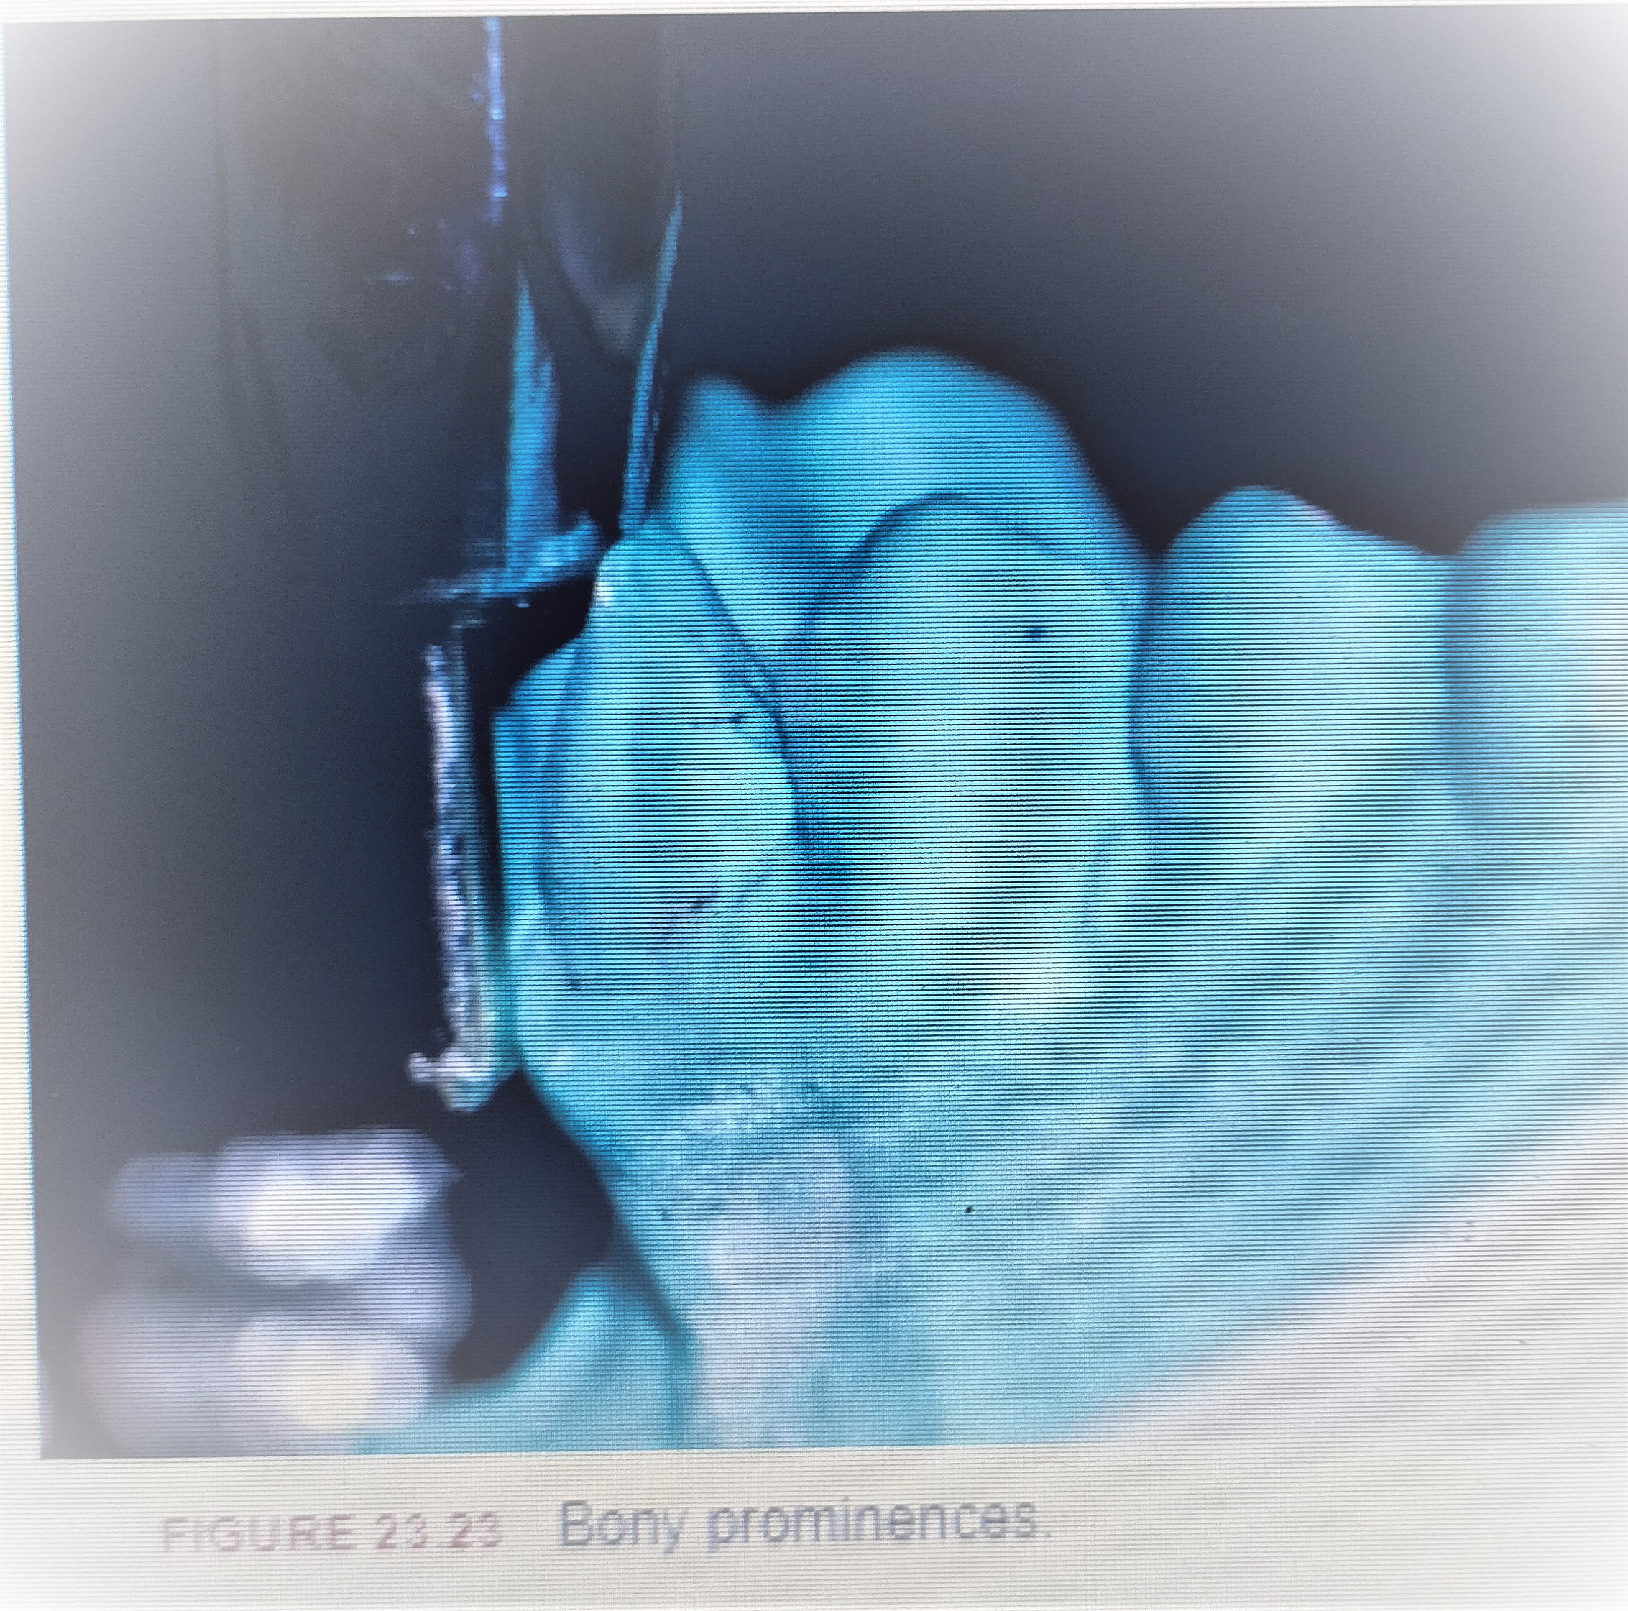

Slide 25
Interferences in maxilla
1. Palatal torus: Change of major connector design to avoid the torus or surgery is indicated when interference with a palatal torus occurs
2.Bony prominence and undercuts: These occur buccal to posterior edentulous ridges. If these are relieved, it can lead to food entrapment in the space created under the denture base and decreased denture stability . They can be corrected surgically.
3. Facial tipping of posterior teeth: This raises the height of contour to a more occlusal level, making placement of retentive buccal clasp arms unaesthetic and at a mechanical disadvantage, increasing forces on the abutmen. Gingival tissues are also undercut in this situation contraindicating the use of bar clasp. If the tipping is unilateral, titling will lower the height of contour. If bilateral, recontouring of enamel can be performed if tipping is slight. If severe, crowning may be the only option.

Slide 26
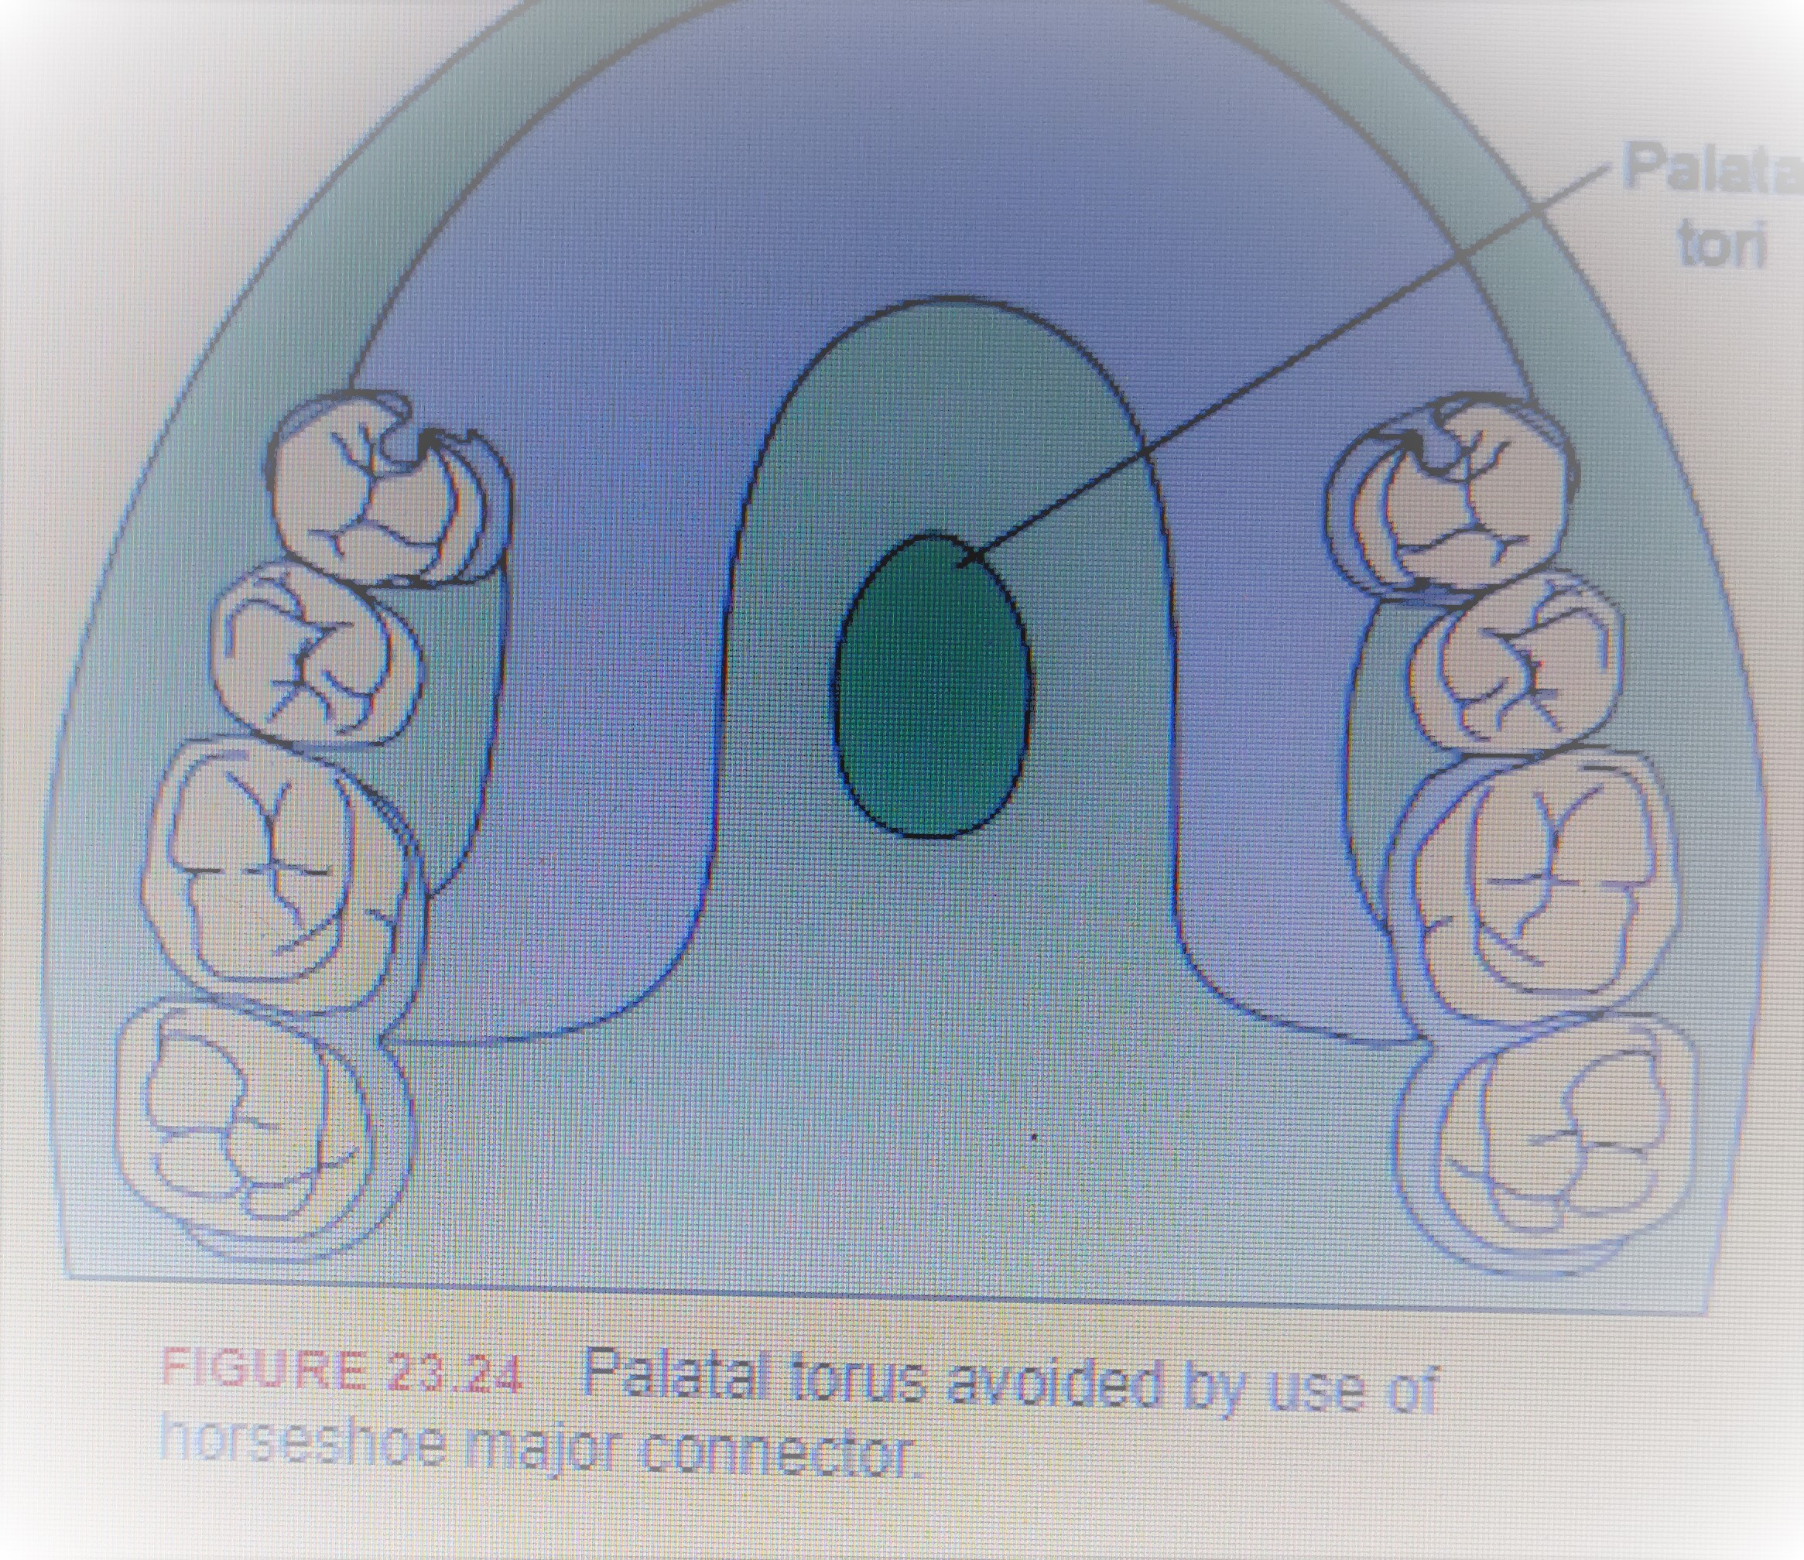

Slide 27
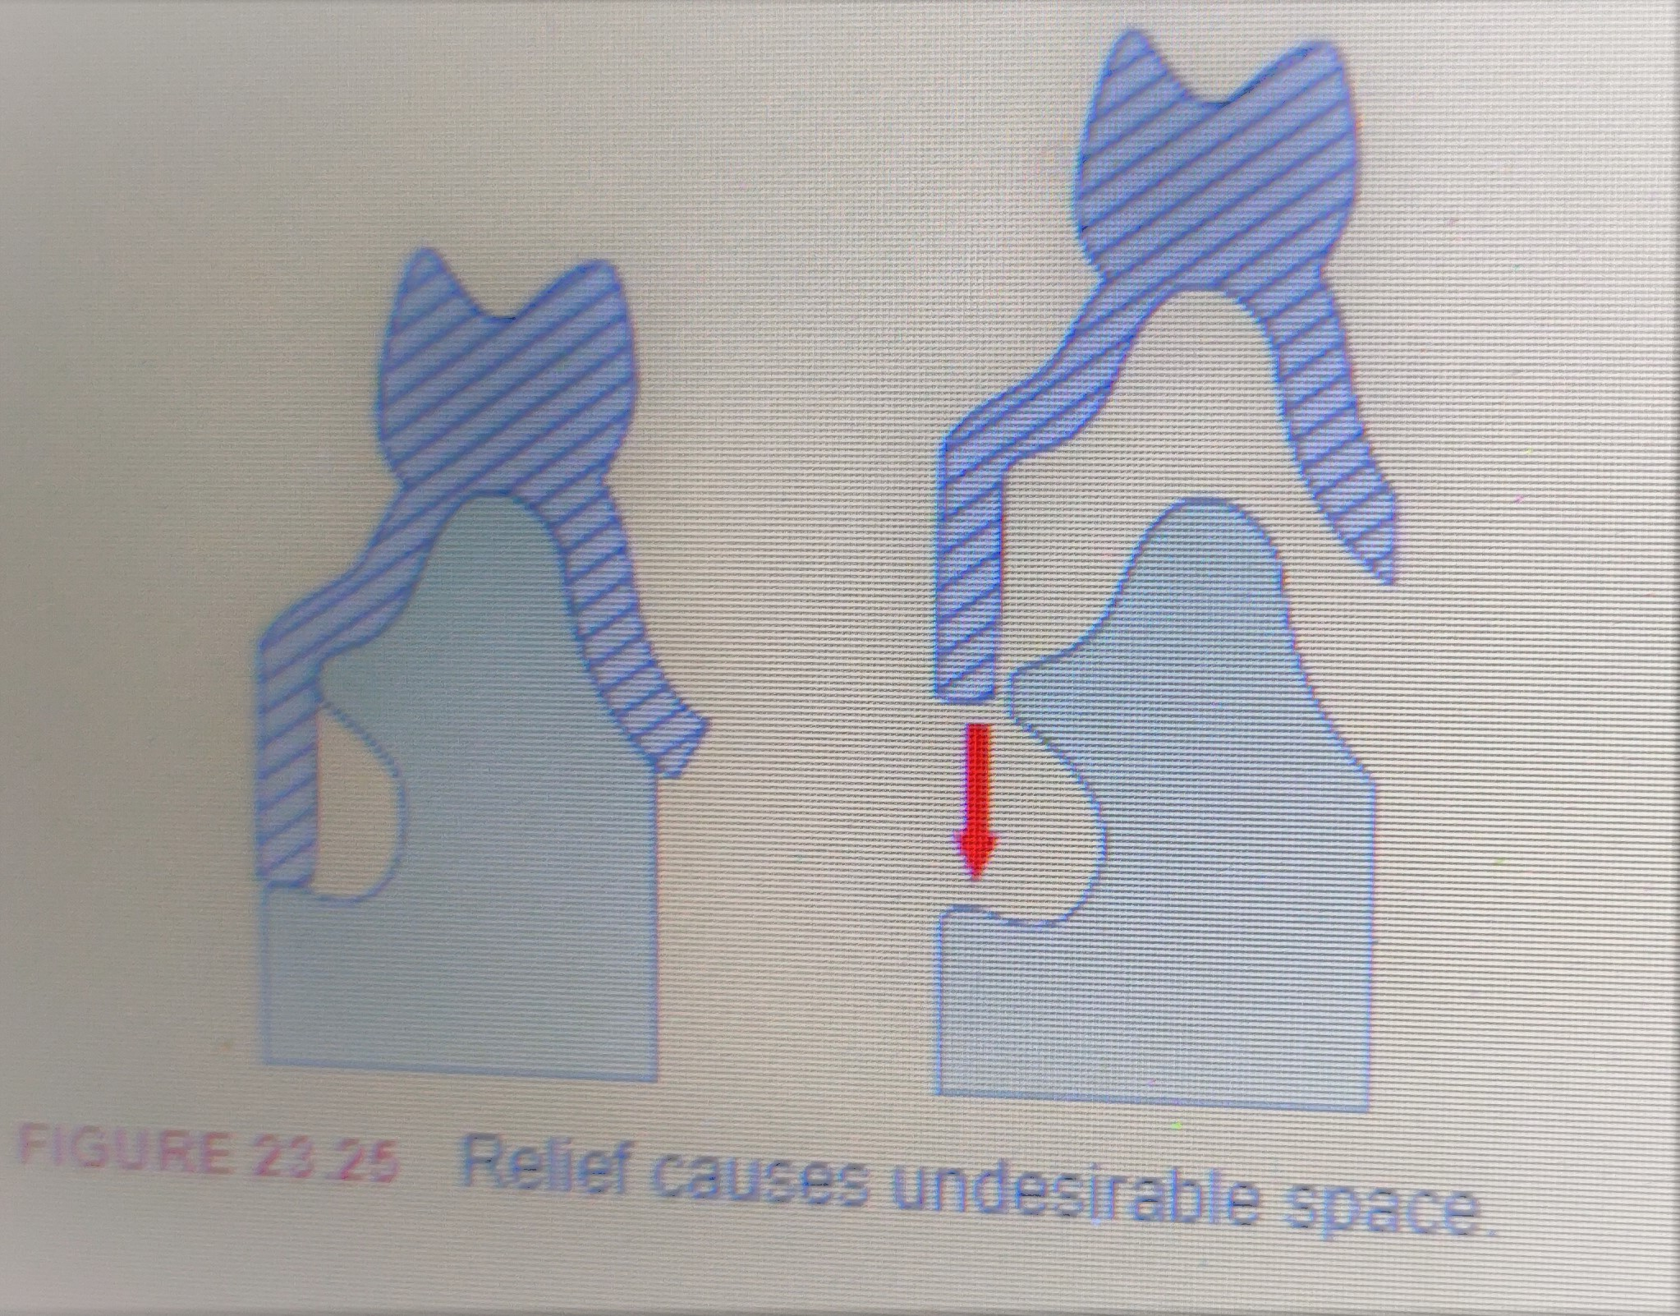

Slide 28
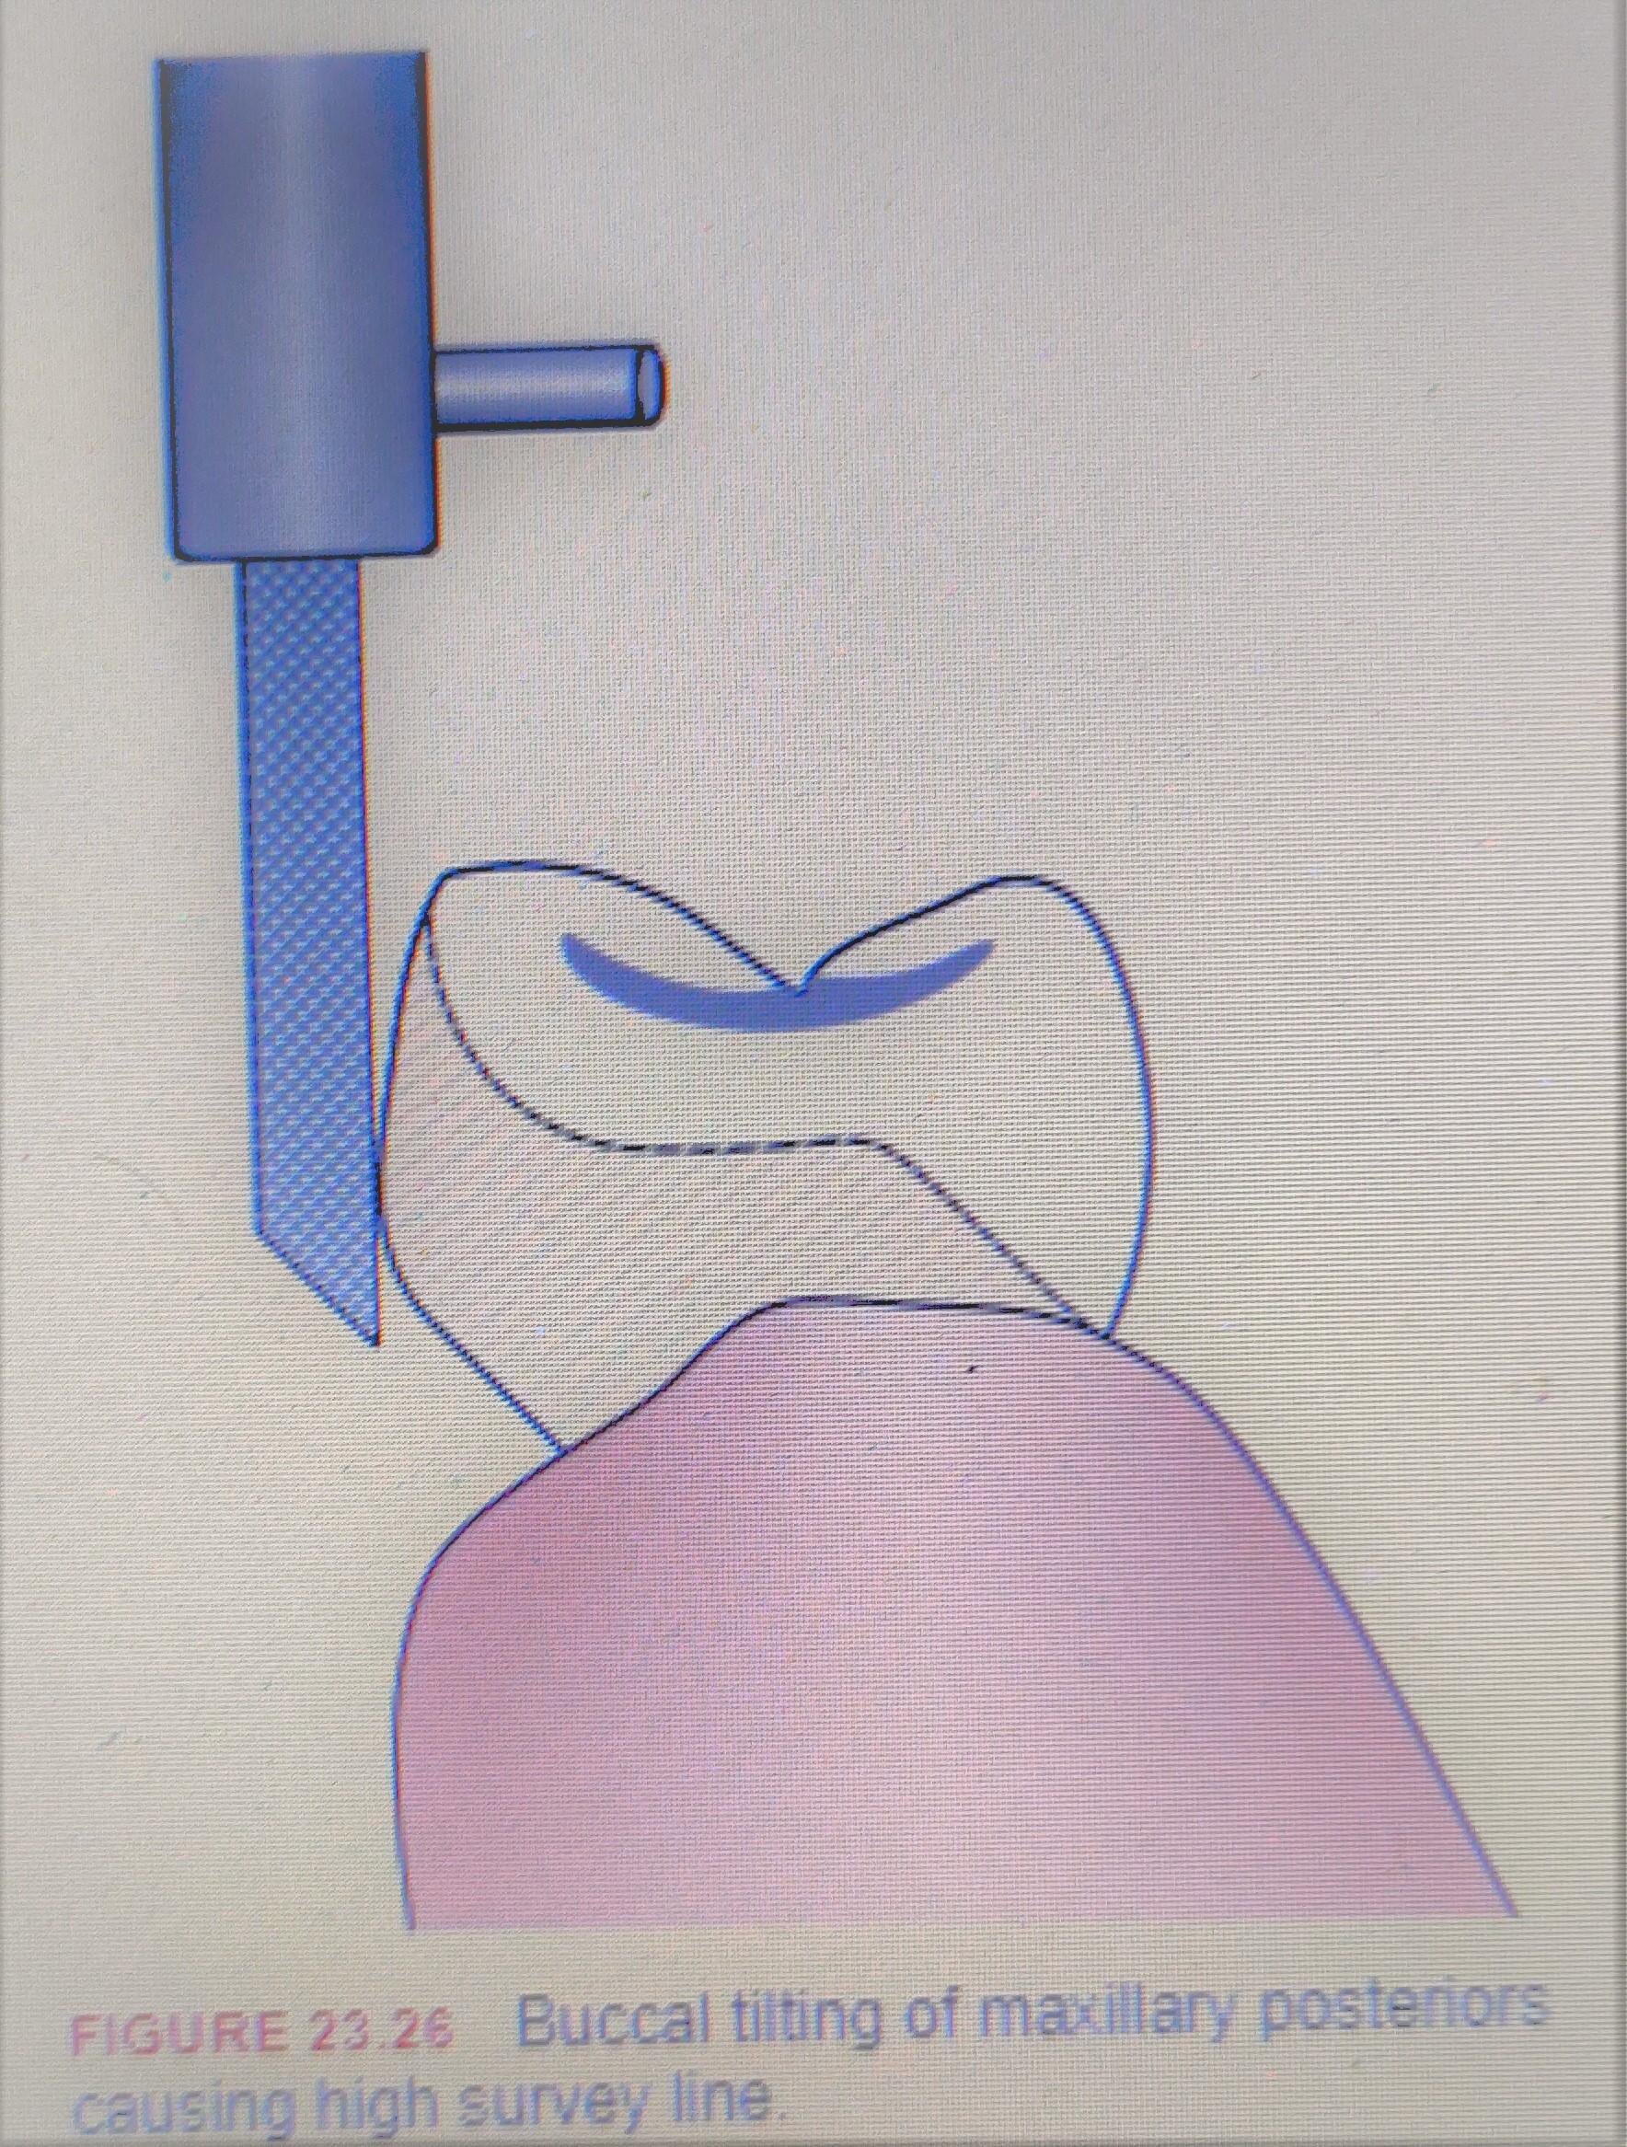

Slide 29
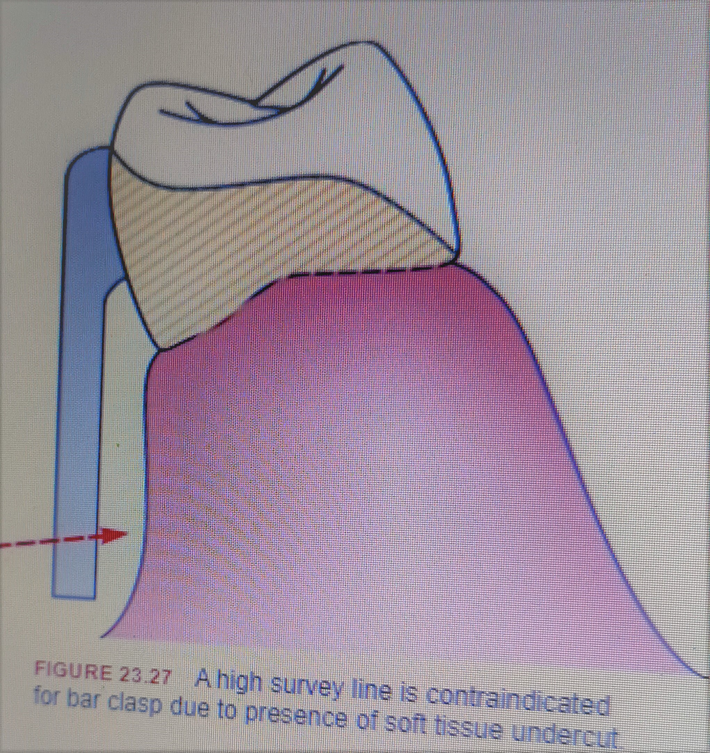

Slide 30
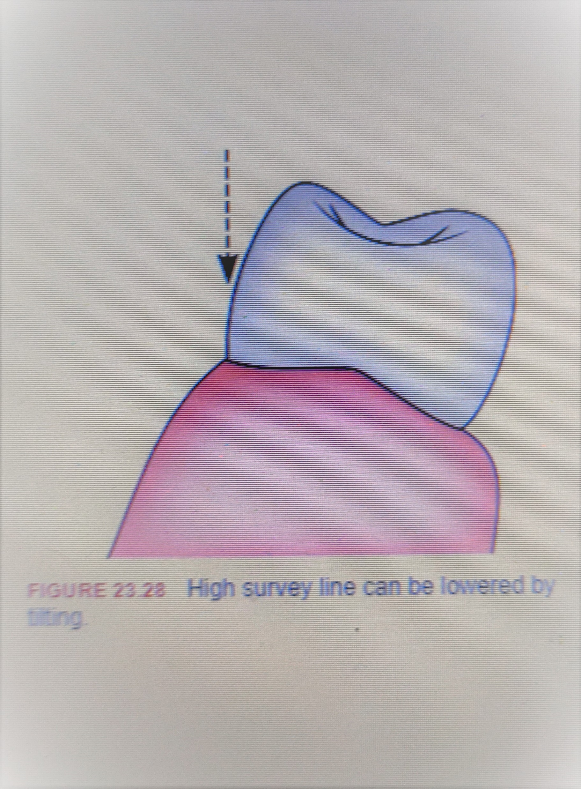

Slide 31
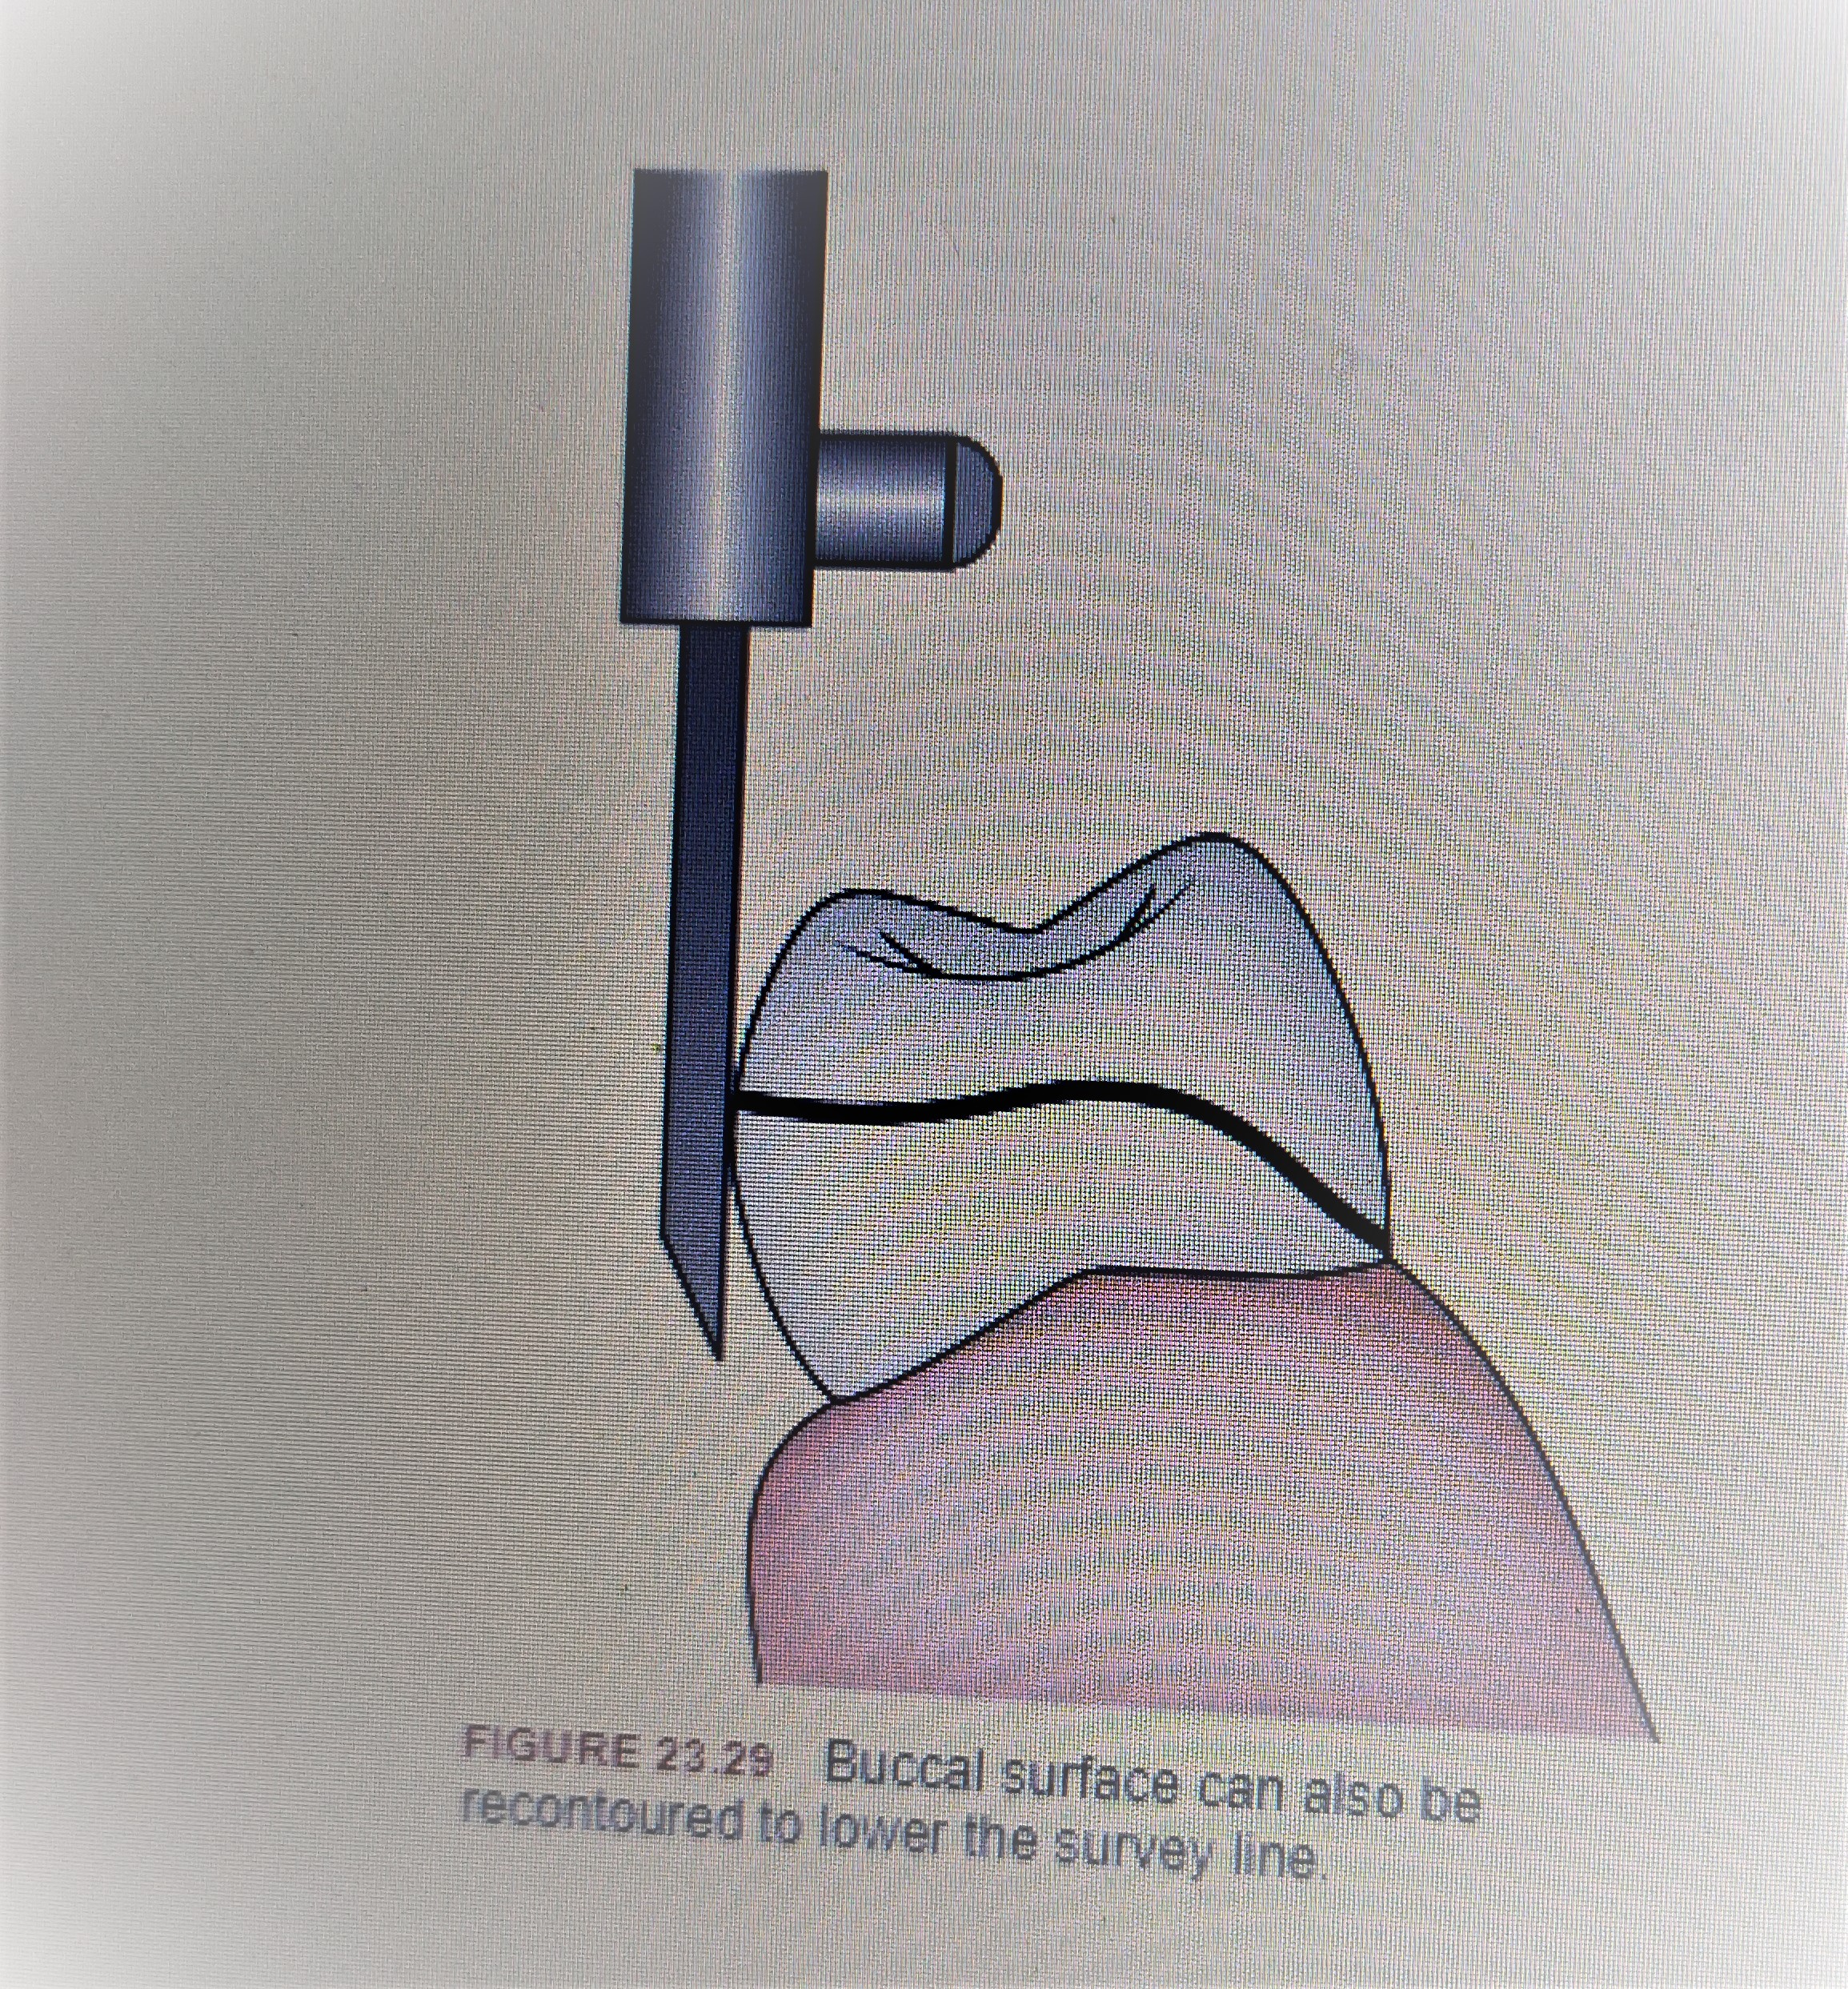

Slide 32
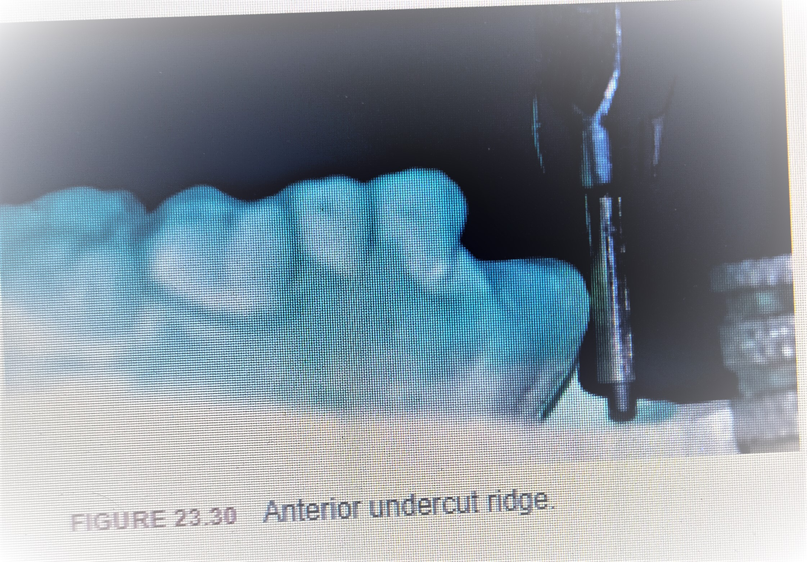

Slide 33
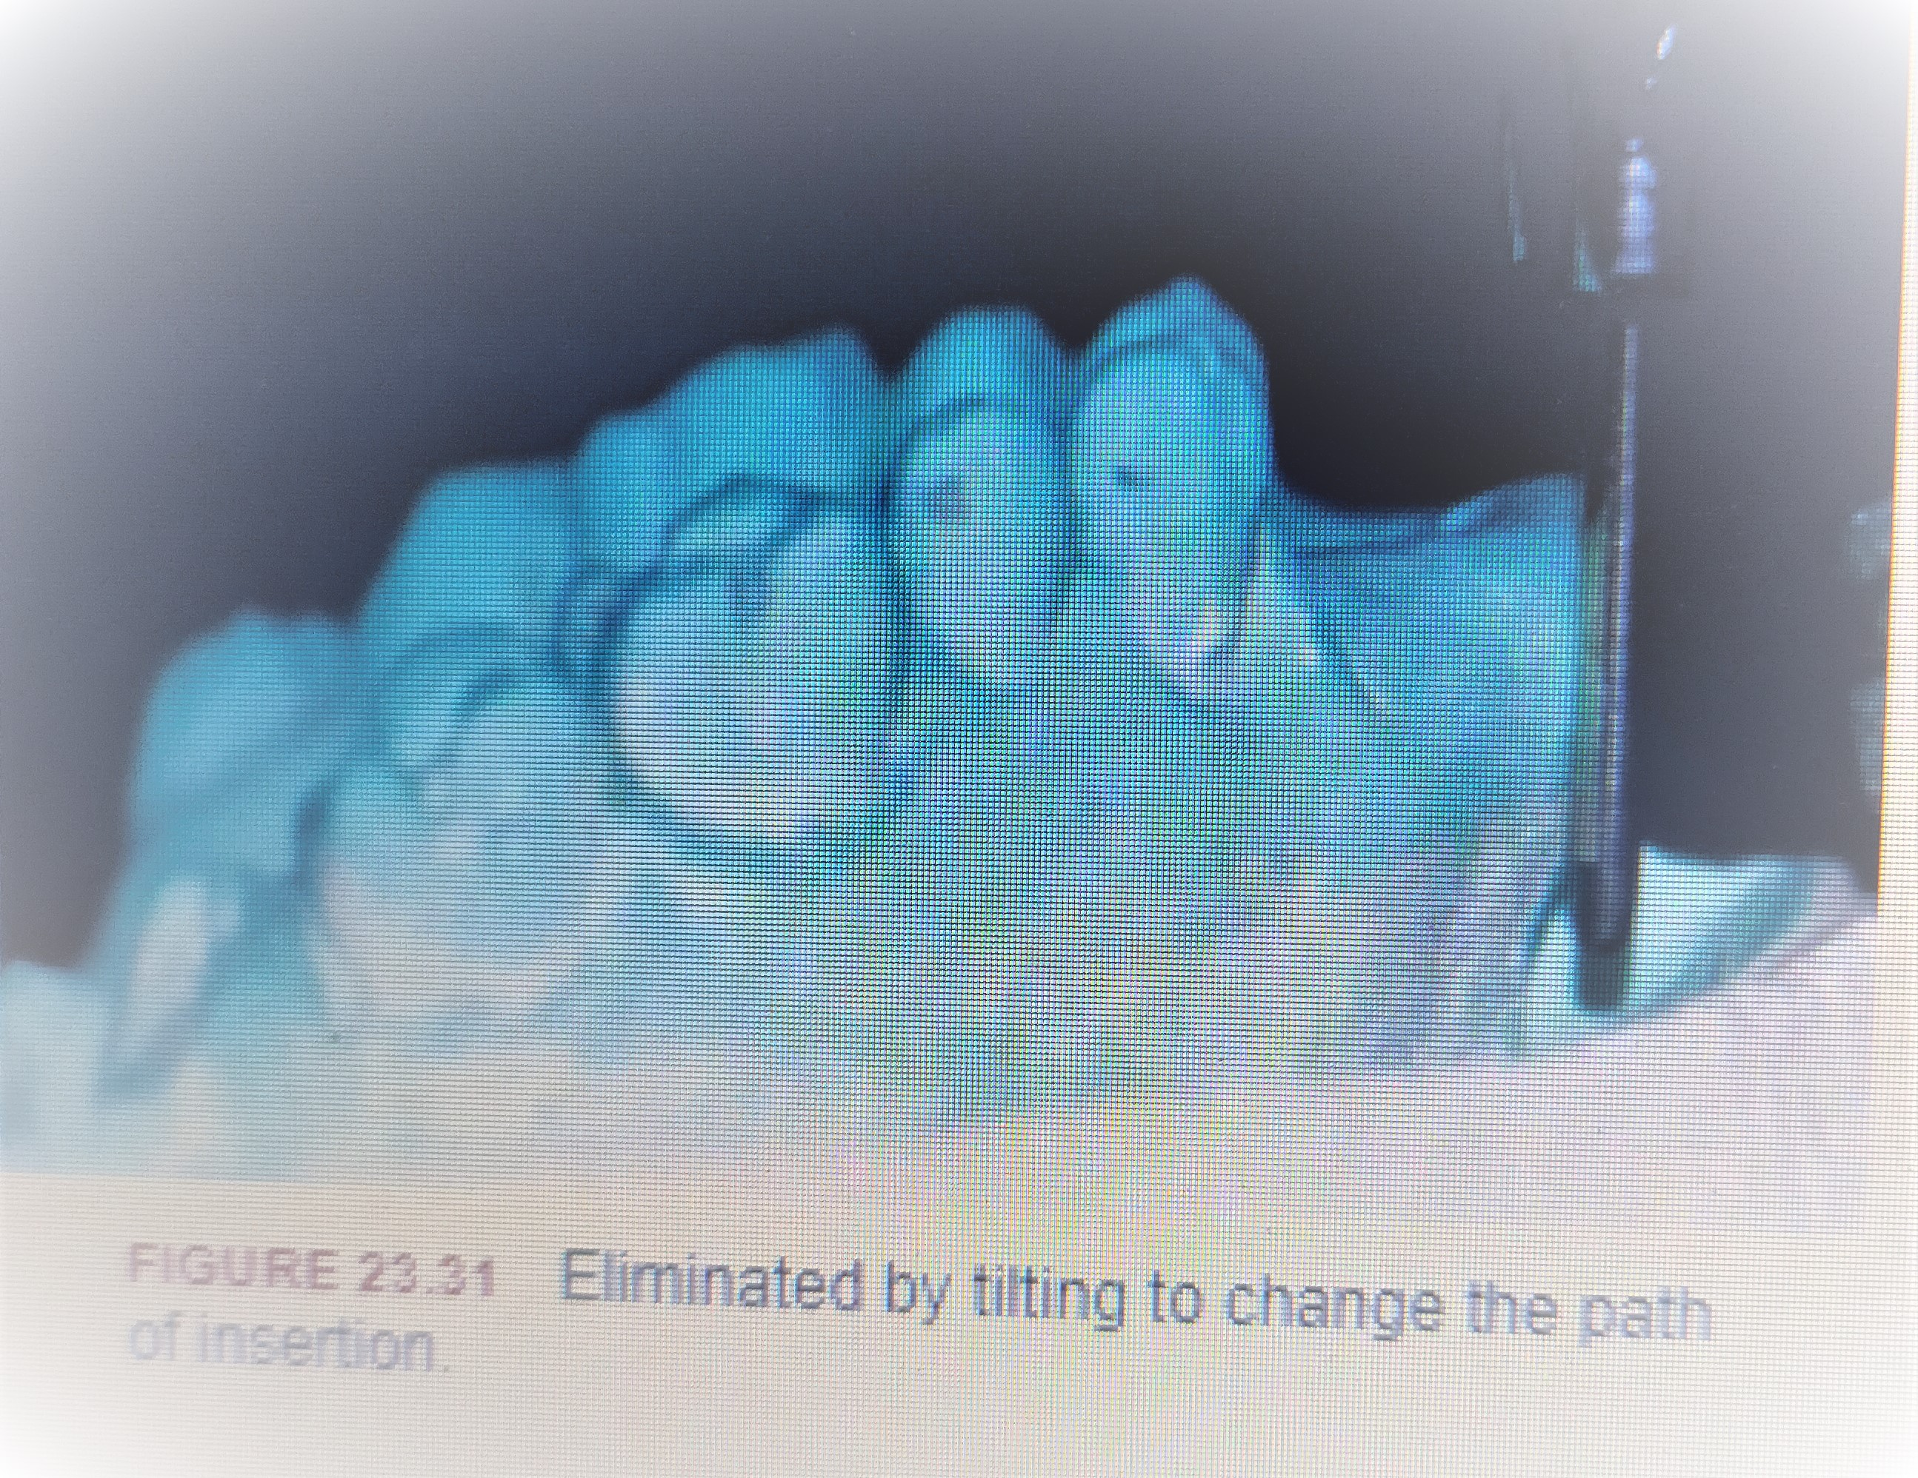

Slide 34
3. Aesthetics
To optimize aesthetics the following should be considered:
i. Metallic clasp arms should be concealed as much as possible. This can be achieved by:
a. Tilting cast to lower the height of contour so retentive tip could be placed in gingival third of abutment.
b. Selection of clasp with less metal display – I-bar clasp

Slide 35
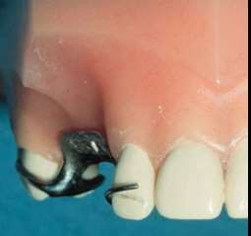
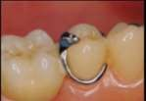

Slide 36
ii. Anterior artificial teeth should be placed in most natural position:
a. Mesial drifting or inclination of remaining anterior teeth occurs when lost anterior teeth are not replaced immediately. The replacement teeth will be smaller than the original. The original size can be restored by recontouring or disking the proximal surfaces adjacent to edentulous space with a surveyor. This not only enhances aesthetics but also creates guide planes to allow only a single path of insertion. Alternately crowns can also be planned if recontouring is not possible.

Slide 37
b. Large undercuts may be seen anteriorly on proximal surfaces of teeth adjacent to edentulous space . If path of insertion is vertical, removable partial denture will be made with this space visible . This is unaesthetic and also causes food entrapment. A posterior tilt will make the path of insertion more labial and will eliminate the space making the prosthesis more aesthetic

Slide 38
4. Guiding planes
These are prepared on the proximal or axial tooth surfaces of the teeth.
• They are created by the contact of the minor connectors and other rigid components of the partial denture against the prepared proximal tooth surface.
• They help in insertion and removal of prosthesis without any undesirable forces on the abutments. Hence, it should be parallel to the path of insertion.
• Using the analysing rod of surveyor, the proximal surfaces of the abutments that can be made parallel to each other are identified by anteroposterior tilting of the cast. The guide planes are then prepared by recontouring the proximal enamel surface. Rarely crowning of the abutment may be necessary to create guide planes

Slide 39
Sometimes the lingual surface of crowns is made parallel to the path of placement by creating a ledge in wax pattern. This contact of the reciprocal component will also create a guiding plane.
• Form: Width should be two-third the distance between the buccal and lingual cusp tips or one-third the buccolingual width of tooth. Height should be about two-third the length of the crown from the marginal ridge cervically. In general, it should be 2–3 mm in height occlusogingivally.

Slide 40
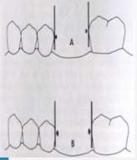
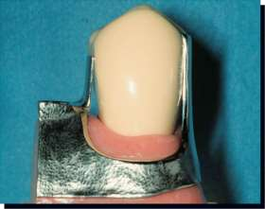

Slide 41
• Functions:
○ Make insertion and removal of prosthesis easier for patient.
○ Provide resistance to horizontal forces.
○ Minimize wedging forces on abutments.
○ Aid in stabilising individual teeth.
○ Minimize space between prosthesis and abutments and reduce food entrapment.
○ Contribute to retention of prosthesis.

Slide 43
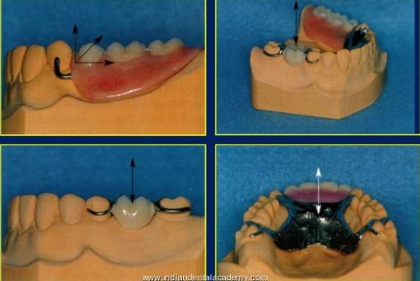
NUMBER OF PATH OF INSERTION:

Slide 44
Tripoding or tripod marking
Definition : Those marks or lines drawn on a cast in a single plane perpendicular to the survey rod to assist with repositioning the cast on a dental surveyor in a previously defined orientation.
The final position (tilt) of the cast in relation to the horizontal plane has to be recorded so that the cast could be placed back on the surveyor for any later analysis if necessary. This is called ‘tripoding’. This can be achieved by the following two methods:

Slide 45
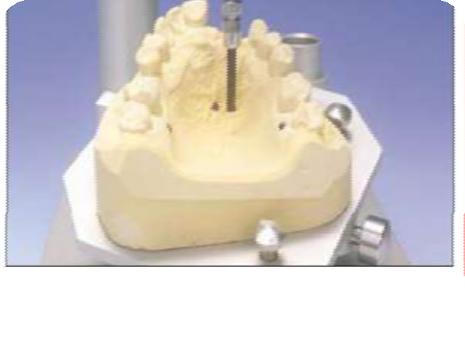
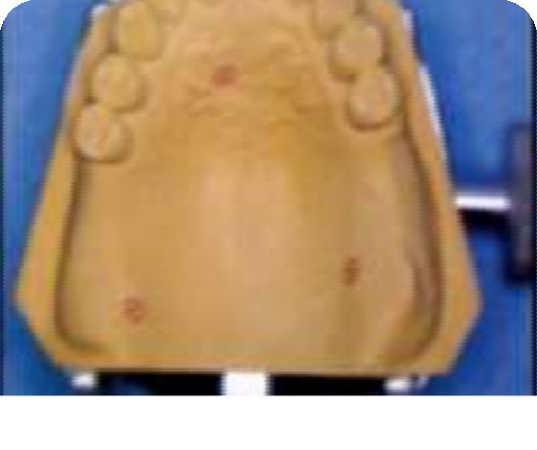
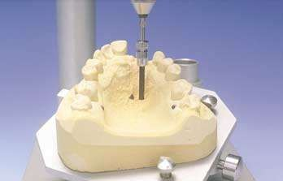



Slide 46
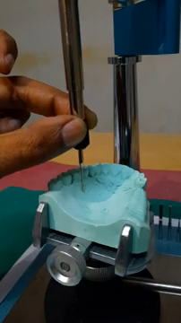
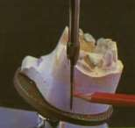

Slide 47
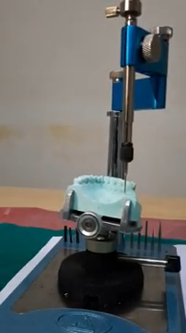

Slide 48
Tissue surface indexing Cast with determined final tilt is locked on surveyor table. The vertical arm of surveyor is also locked such that it contacts the tissue surface of the cast. Horizontal arm can be moved.
Undercut gauge is attached to the mandrel, and three widely divergent marks are created on the tissue surface by pressing the gauge against the cast. These marks are then highlighted in pencil by making a cross and circling it . These marks should not be placed on areas of cast involved in framework design . This will establish three points in the same horizontal plane and permit the cast to be repositioned precisely

Slide 49
Art portion indexing
This is the second method to tripod the cast.
Three lines and marks are scribed, one on the posterior, and one each on the lateral surface of the art portion or base of the cast. This is done by holding the analysing rod against the side of the cast and making a mark with a sharp instrument . All other procedures are the same as before. By tilting the cast until all three lines are again parallel to the surveyor blade, the original cast position can be re-established.

Slide 50
Transferring tripod marks to another cast
In both the above methods, scoring (making a mark) the cast rather than just drawing the marks with pencil or carbon marker, has the advantage that if the cast is duplicated, the marks will also be transferred from one cast to another.
It is thus possible to transfer the tripod marks from a master cast to a refractory cast. If the marks successfully are to be transferred from the diagnostic cast to a master cast, as there is no duplication done here, the diagnostic cast .
The commonly used landmarks are: 1. Distal marginal ridge of first premolar on one side. 2. Lingual cusp tip of first premolar of opposite side. 3. Incisal edge of lateral incisor.

Slide 51
Since these points can be easily marked on any other cast of the same patient (master cast), it can be repositioned in the same orientation as diagnostic cast.
Once final path of placement of prosthesis is determined and the same is tripoded for future reference, the survey line is marked on the cast by the surveyor.

Slide 52

Survey lines
Definition: A line produced on a cast by a surveyor marking the greatest prominence of contour in relation to the planned path of placement of a restoration.
Blatterfein divided the abutment tooth into two halves by a vertical line through the centre of the tooth. The area adjacent to edentulous space was termed as near zone and the other area was called far zone

Slide 54
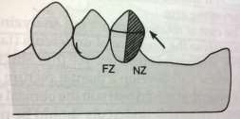
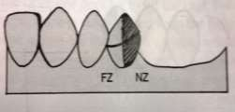
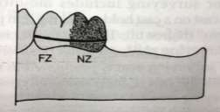
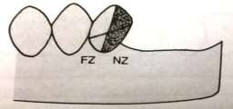
HIGH SURVEY LINE: From occlusal 1/3rd in NZ to occlusal 1/3rd in FZ
MEDIUM SURVEY LINE: From occlusal 1/3rd in NZ to middle 1/3rd in FZ.
LOW SURVEY LINE: From cervical 1/3rd in NZ to cervical 1/3rd in FZ
DIAGONAL SURVEY LINE: From
occlusal 1/3rd in NZ to gingival 1/3rd in FZ

Slide 55
Medium survey line It passes from middle third of the tooth in the near zone to the gingival third of the tooth in the far zone . Preferable to tilt and produce this survey line whenever possible. Both circumferential and bar clasps can be used with this survey line.
Diagonal survey line It passes from near the occlusal third in the near zone to the gingival third in the far zone . Commonly found on buccal surface of canines and premolars. Circumferential reverse circlet and hair pin clasps can be used or ‘T’ and ‘modified T-bar’ clasp can be used.

Slide 56
High survey line It is placed in the occlusal third in both near and far zones . Inclined teeth produce this survey line. A wrought wire combination clasp can be used to engage this deep undercut. Ring clasp can also be used on lone-standing abutments which are tilted and have high survey line. It can be changed to a medium survey line by tilting, recontouring or crowning.
Low survey line It is placed in the gingival third of both near and far zones. It better to change contour by tilting, recontouring or crowning. Following tripoding, the survey line is marked on all the remaining teeth by fixing the carbon marker on the surveying arm of surveyor

Slide 57
The designed diagnostic cast is used as a guide for mouth preparation and after the same is completed, the master cast is made. The master cast with the designed diagnostic cast is then sent to laboratory for surveying the master cast.

Slide 58
Survey of master cast
Master cast is tripoded in same relation as diagnostic cast using tripoding.

Slide 59
blockout
The purpose of applying wax or another similar temporary substance to undercut portions of a cast so as to leave only those undercut essential to the planned construction of prosthesis or elimination of underisable undercuts on a cast.

Slide 60
Technique 1.Parallel blockout
It could be made with zero degree,2 degree and 4* tapered styli.
Selection depends on need for increased freedom of movement of prosthesis in function.
Tapered blockout is indicated for distal extension partials to allow some movement in functions.
Generally these blockout is done cervical to guiding plane surface and all undercut areas that will be crossed by major or minor connector.
Proximal tooth surface
Beneath all minor connector

Slide 61
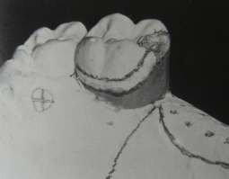

Slide 62
Tissue undercut crossed by the rigid connector
Deep interproximal spaces to be covered by minor connector or linguoplates
Bar clasp arm to gingival crevices

Slide 63
2.Arbitrary blockout
Areas of undercut not involved with framework
This minimizes distortion during duplication.
Not contoured with blockout instrument
1.all gingival crevice
2.gross tissue undercut situated below areas involved in design of framework
3.tissue undercut distal to cast framework
4.labial and buccal tooth and tissue undercut

Slide 64
3.Shaped blockout
Ledges made on buccal and lingual surfaces to help place the plastic or wax pattern for clasp arm.
Following duplication,these ledges will help for placement of retentive clasp patterns.

Slide 65
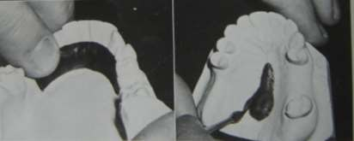
relief
The reduction or elimination of underisable pressure or force from a specific region under a denture base.
This is also used for the creation of space for material.
This involves addition of wax to stand away from the master cast

Slide 66
Summary
The surveyor is an essential tool in the diagnosis and treatment planning of RPD.
Surveying helps design a removable partial denture such that the rigid and non-rigid components of the prosthesis will go into the mouth as a single unit, free from interferences, and in the mouth,will resist disloging forces.
The procedure involves surveying the diagnostic cast and master cast.
The lab procedures involved in the construction of the framework are continued after this survey of master cast.

Slide 67
Take home message
The surveyor is an essential tool in the diagnosis and treatment planning of RPD.
Surveying helps design a removable partial denture such that the rigid and non-rigid components of the prosthesis will go into the mouth as a single unit, free from interferences, and in the mouth,will resist disloging forces.
The procedure involves surveying the diagnostic cast and master cast.
The lab procedures involved in the construction of the framework are continued after this survey of master cast.

Slide 68
References
Removable partial prosthodontics 11th edition Mc cracken
Clinical removable partial prosthodontics stewarts
A color atlas of removable partial dentures J.C. Davenport ; R.M. Basker
Advanced Removable Partial Dentures James S. Brudvik
Arthur M. LaVere, and Arthur J. Krol, Selection of a maior connector for the extension-base removable partial denture JPD 1973;30,102-105
Davis Hendersonand Thomas E. Seward Design and force distribution with removable partial dentures: A progress report JPD 1967;17,350-364.

